Slide 1
人工智能引论
宋睿华
中国人民大学人工智能学院

Slide 2
人工智能与视觉
视觉信息的获取方法
卷积神经网络
Transformer的广泛应用

Slide 3


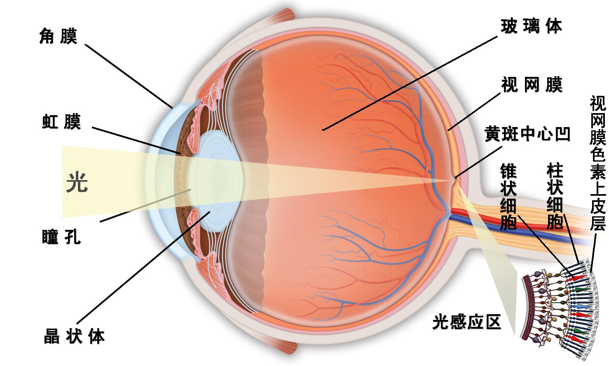
人的视觉感知
Notes:
人眼视觉，视觉神经系统，颜色空间
光，颜色空间
人眼感知
认知神经科学，物体感知

Slide 4
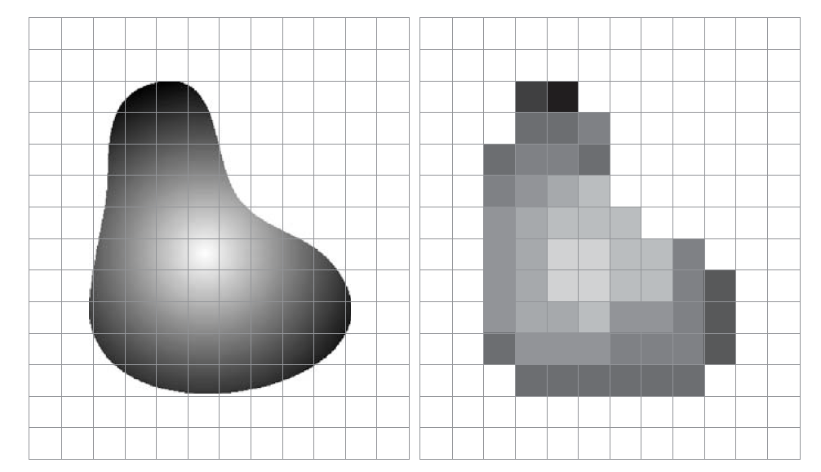
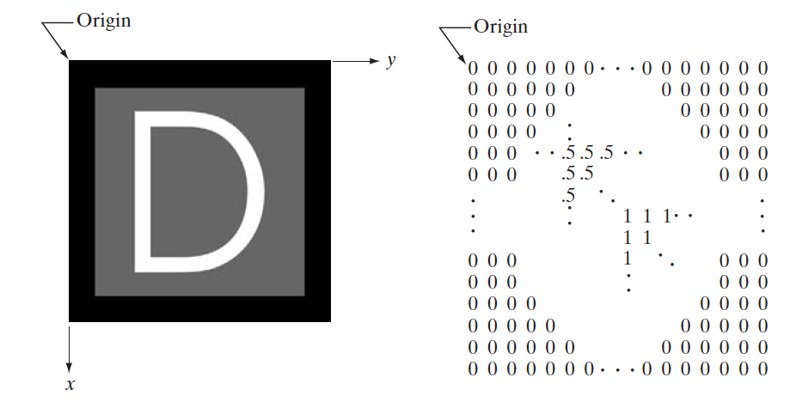
物理图像成像
图像取样与量化
数字图像的表示

Slide 5
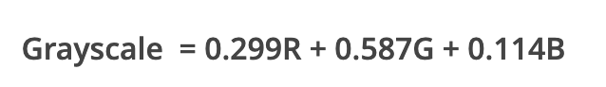
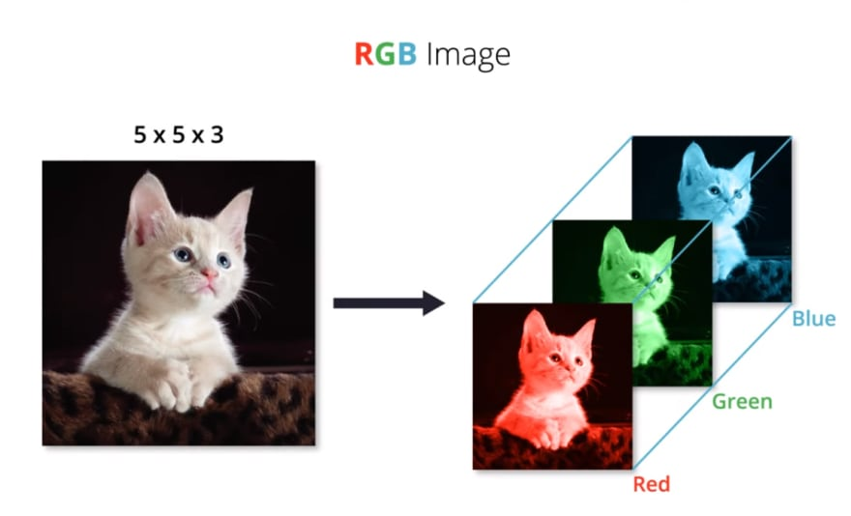
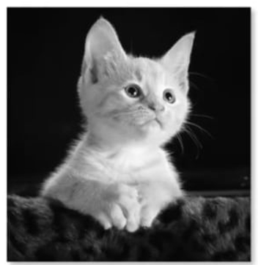
颜色获取与表示
RGB-to-Grayscale 转换（luminosity-based）：
255x255x1
255x255x3
255x255x1
数字图像的RGB表示
数字图像的灰度表示
Notes:
人眼视觉，视觉神经系统，颜色空间
光，颜色空间
人眼感知

Slide 6
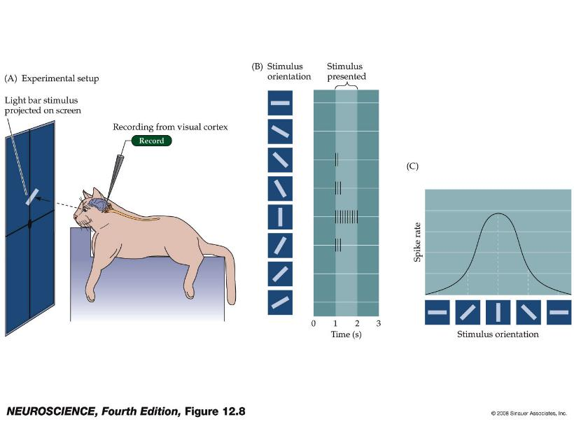

Preferred stimulus of a visual cortex neuron
Part of Nobel prize (1981) work by Hubel and Wiesel
Notes:
Figure 11.9 Neurons in the primary
visual cortex respond selectively to oriented edges.
(A) An anesthetized animal is fitted with contact lenses to focus the eyes on a screen, where images can be projected; an extracellular electrode records the neuronal responses.
(B) Neurons in the primary visual cortex typically respond vigorously to a bar of light oriented at a particular angle and weakly—or not at all—to other orientations.
Instead, most cortical neurons in cats and monkeys responded vigorously
to light–dark bars or edges, and only if the bars were presented at a
particular range of orientations within the cell’s receptive field (Figure 11.9).
The responses of cortical neurons are thus tuned to the orientation of edges,
much like cone receptors are tuned to the wavelength of light; the peak in
the tuning curve (the orientation to which a cell is most responsive) is
referred to as the neuron’s preferred orientation. By sampling the responses
of a large number of single cells, Hubel and Weisel demonstrated that all
edge orientations were roughly equally represented in visual cortex.
As a result, a given orientation in a visual scene appears to be “encoded” in the
activity of a distinct population of orientation-selective neurons.

Slide 7
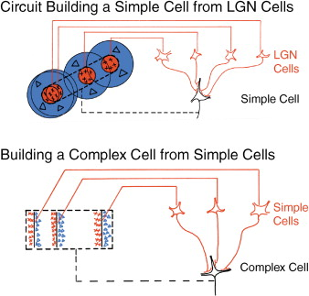
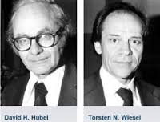
Convolution Neural Network(CNN) Inspired by Simple and Complex Cell in Visual Cortex
Convolution
Pooling
1981 Nobel Prize

Slide 8
人工智能与视觉
视觉信息的获取方法
卷积神经网络
Transformer的广泛应用

Slide 9
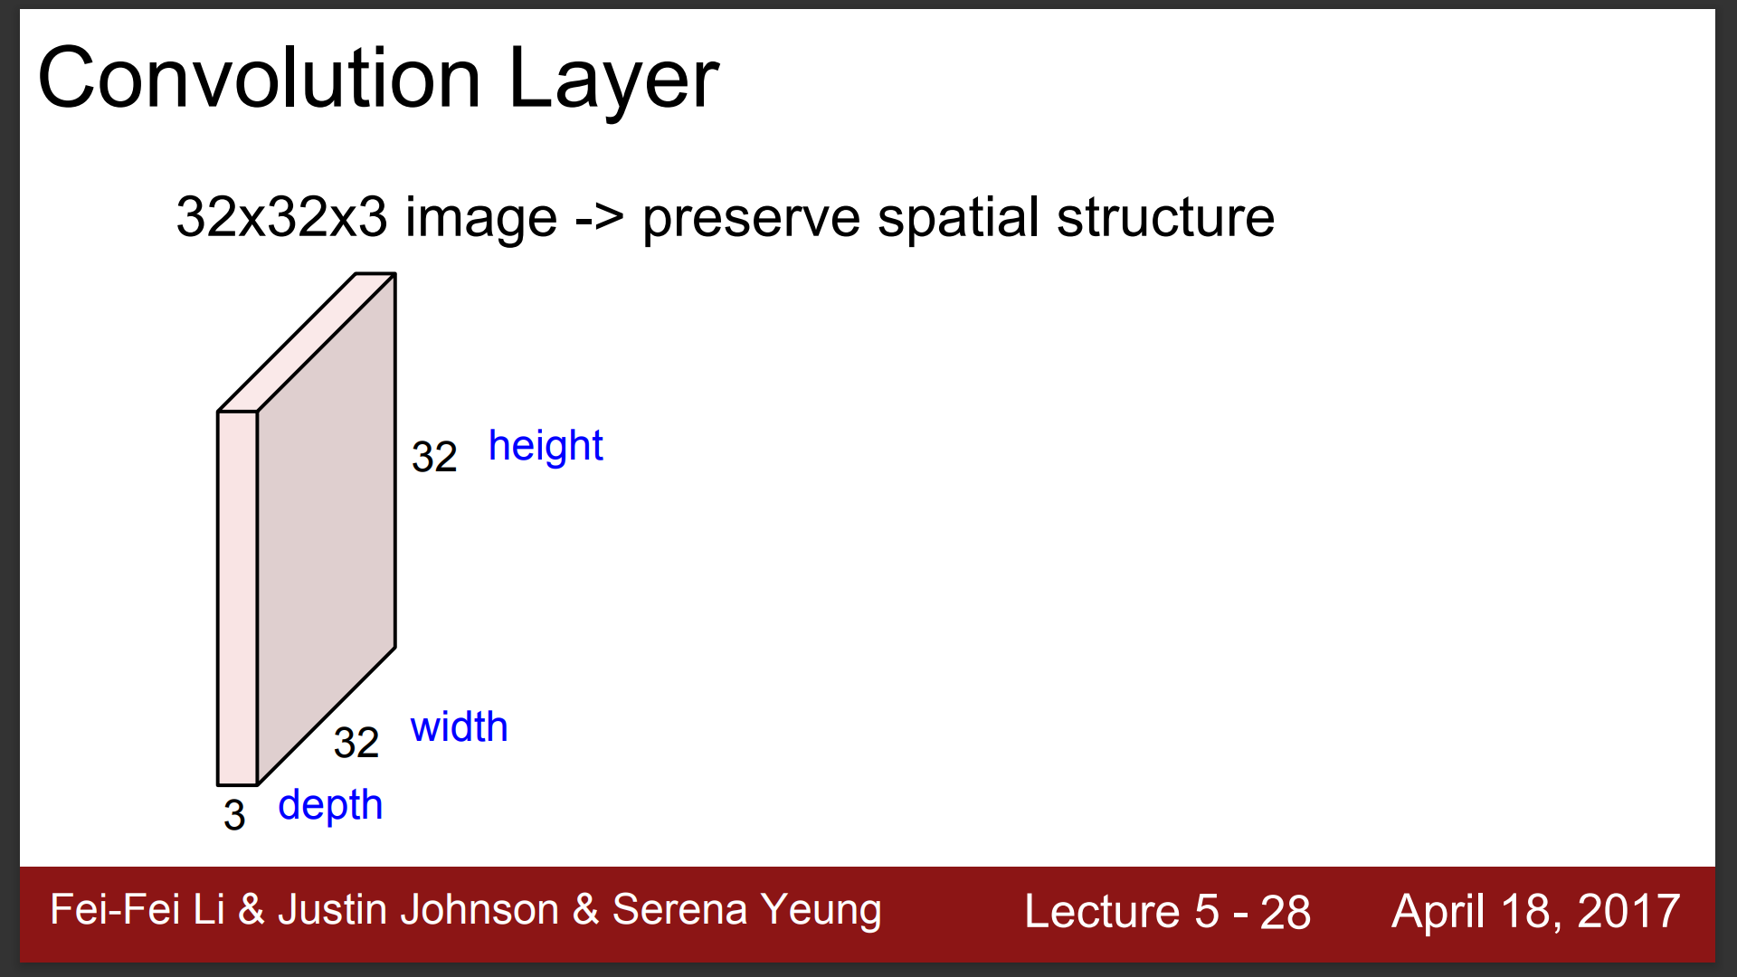

Slide 10
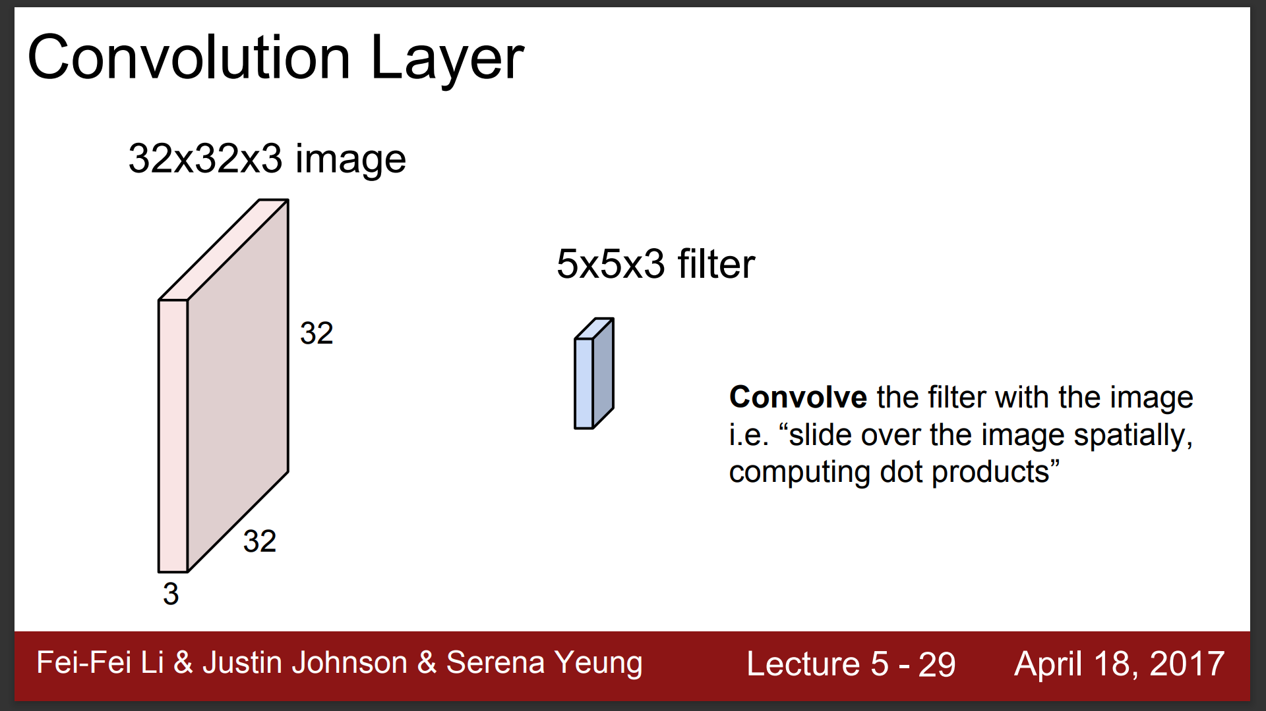

Slide 11
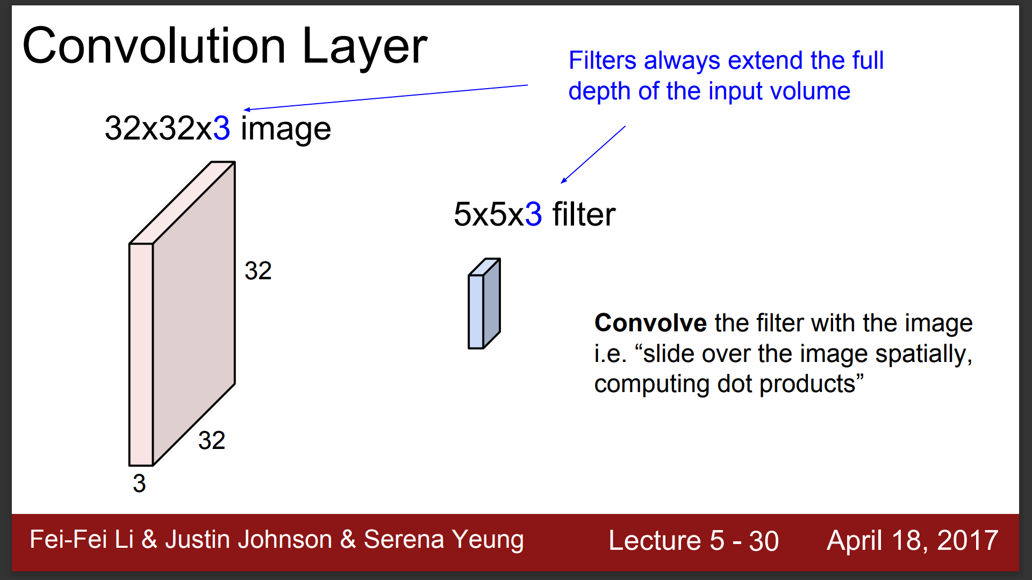

Slide 12
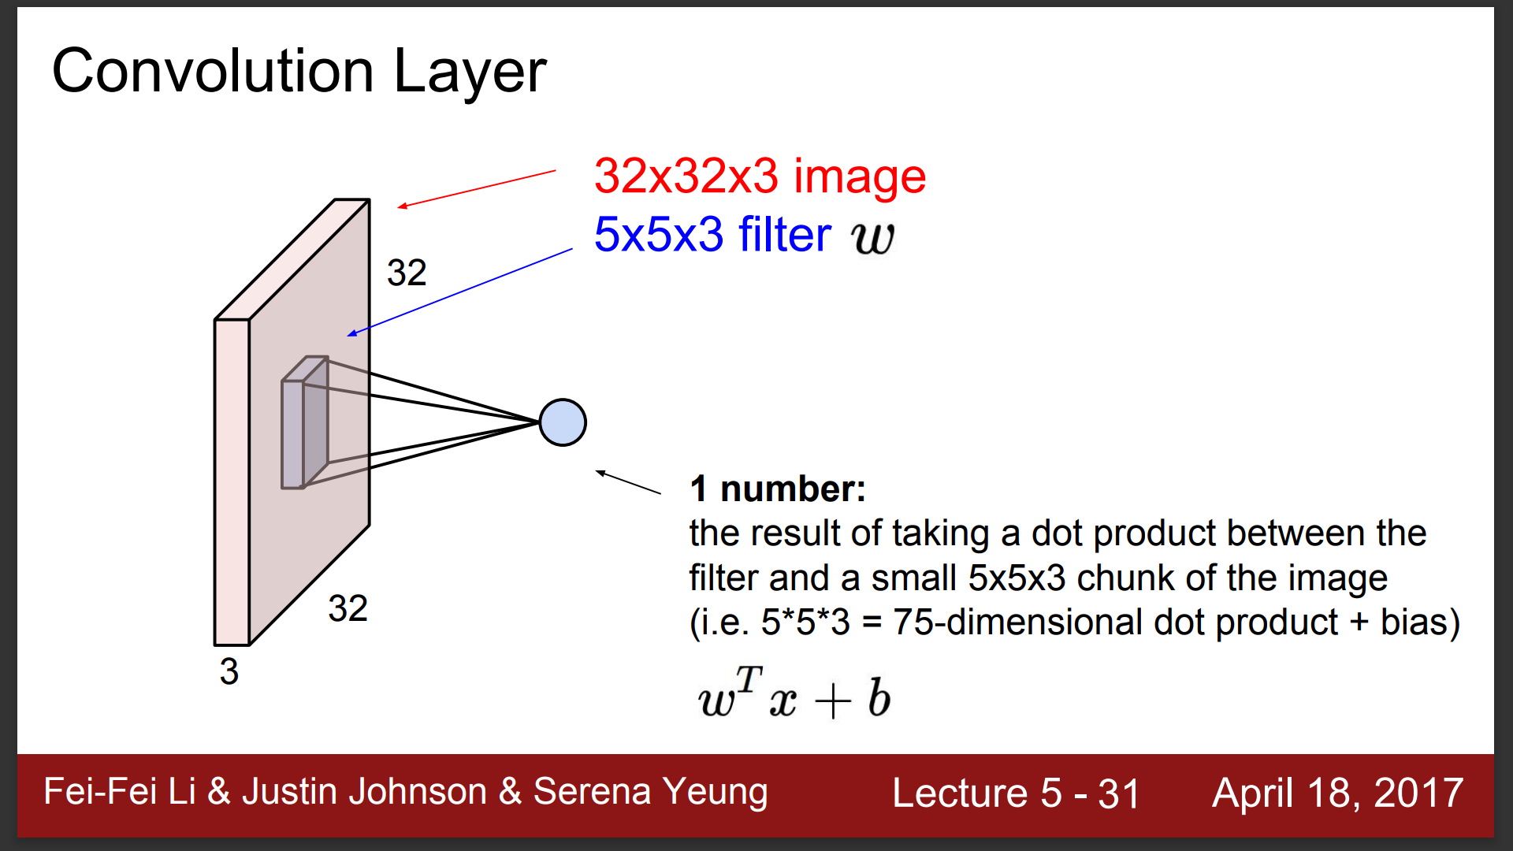

Slide 13
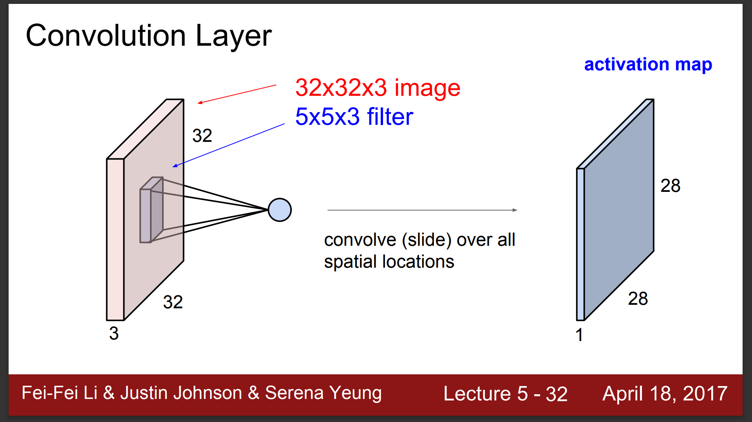

Slide 14
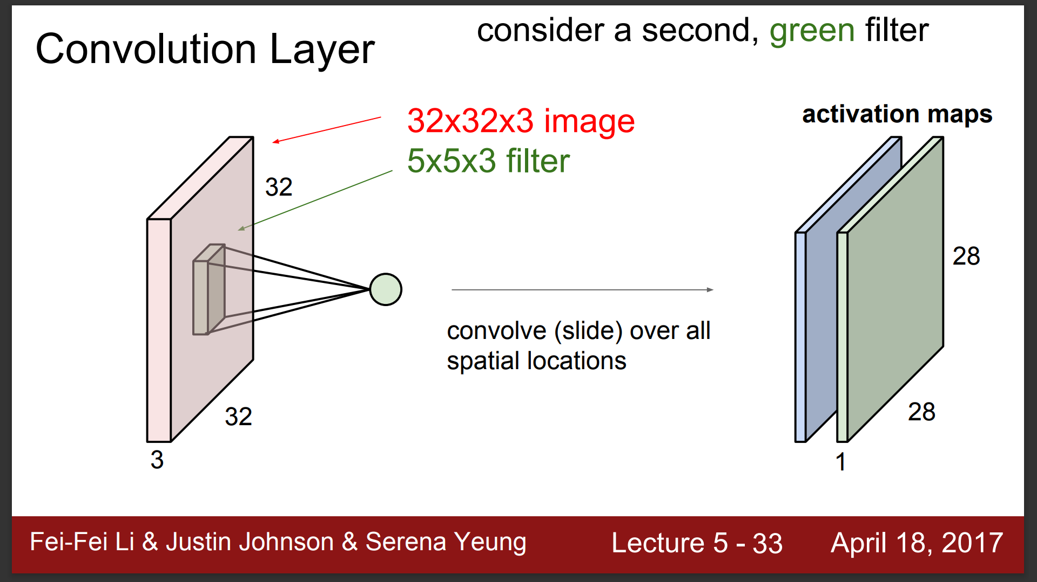

Slide 15
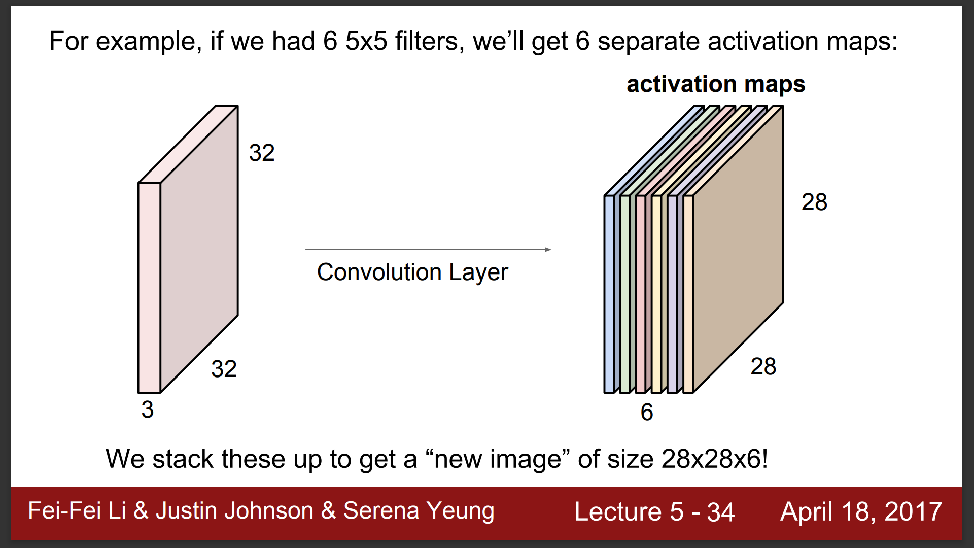

Slide 16
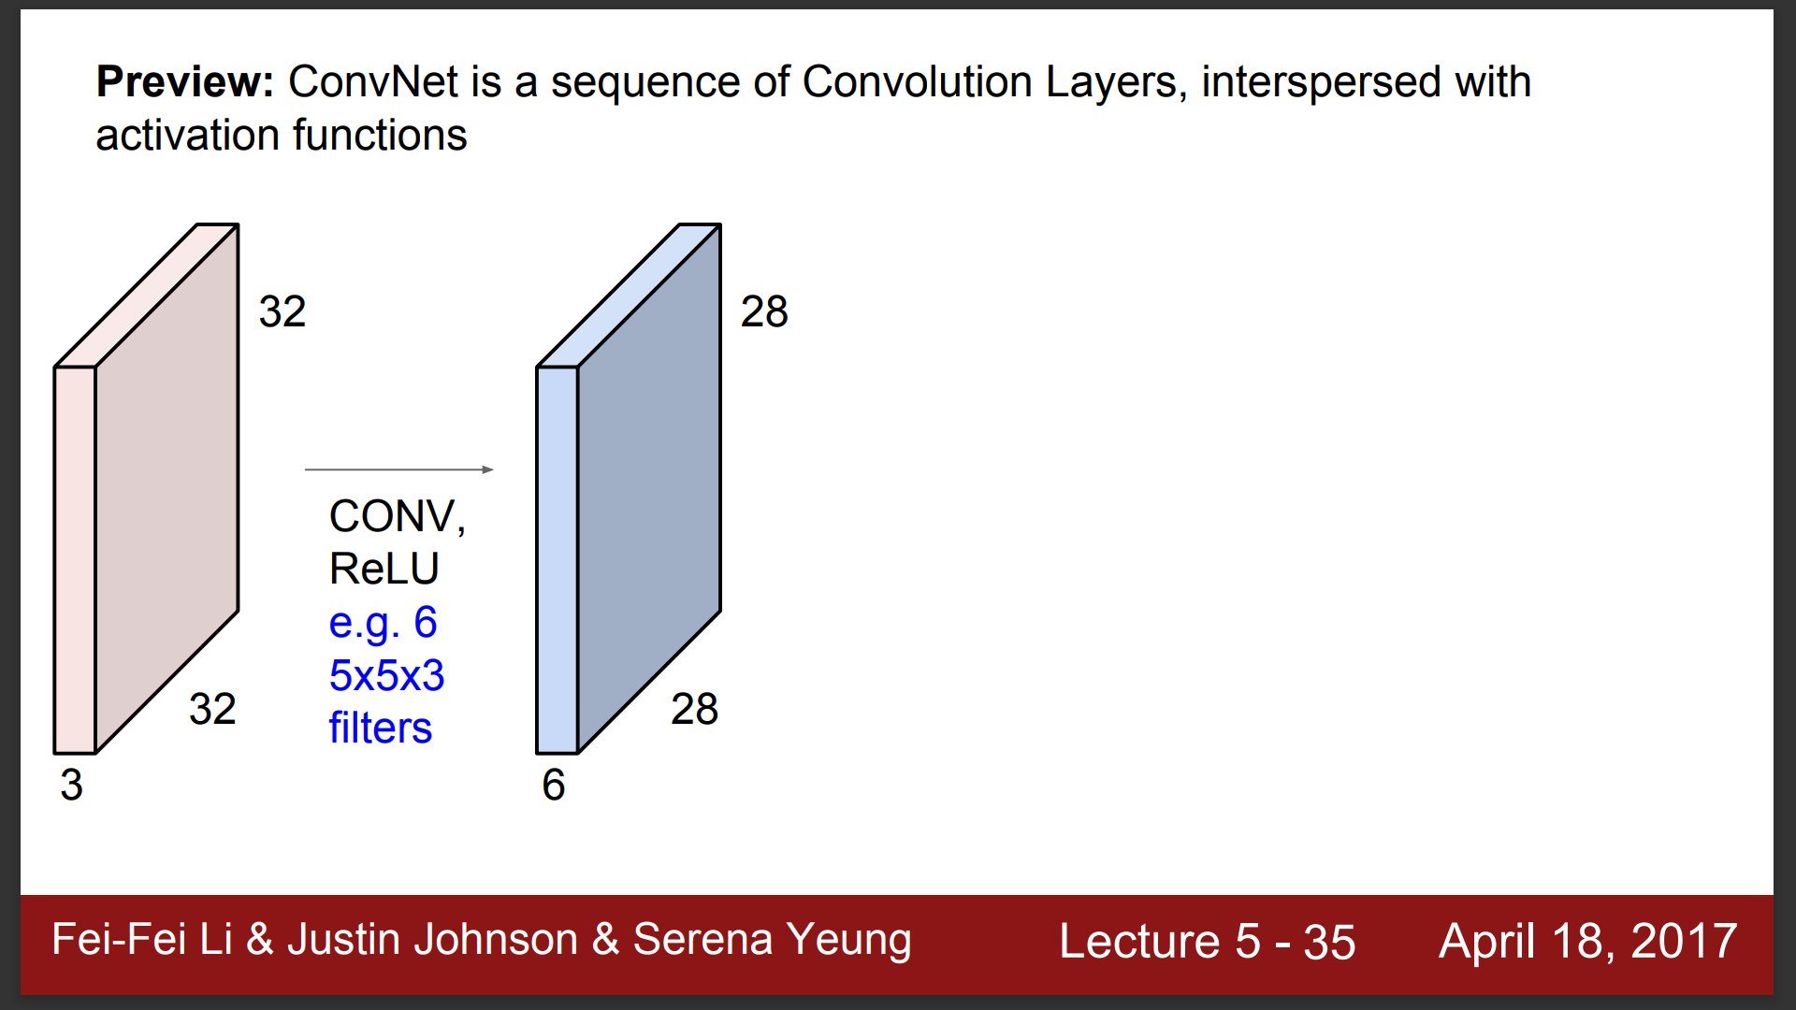

Slide 17
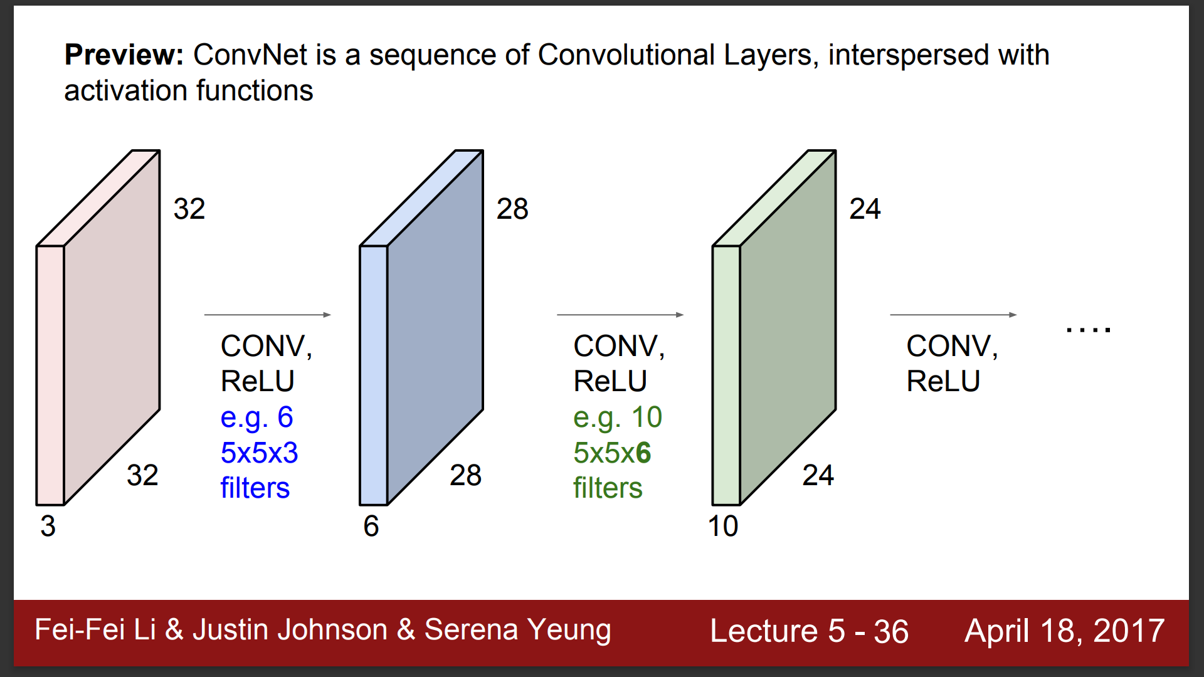

Slide 18
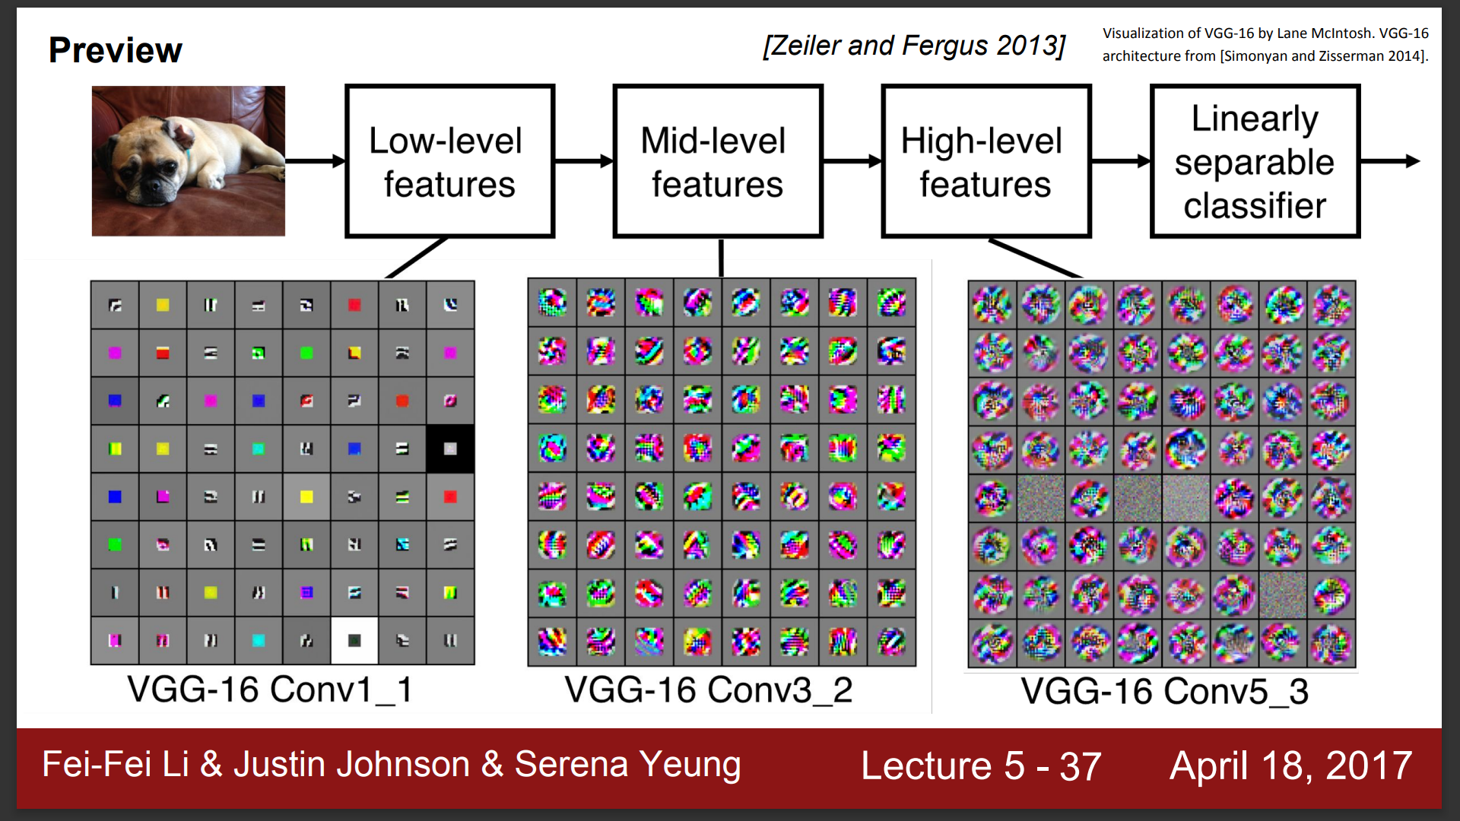

Slide 19
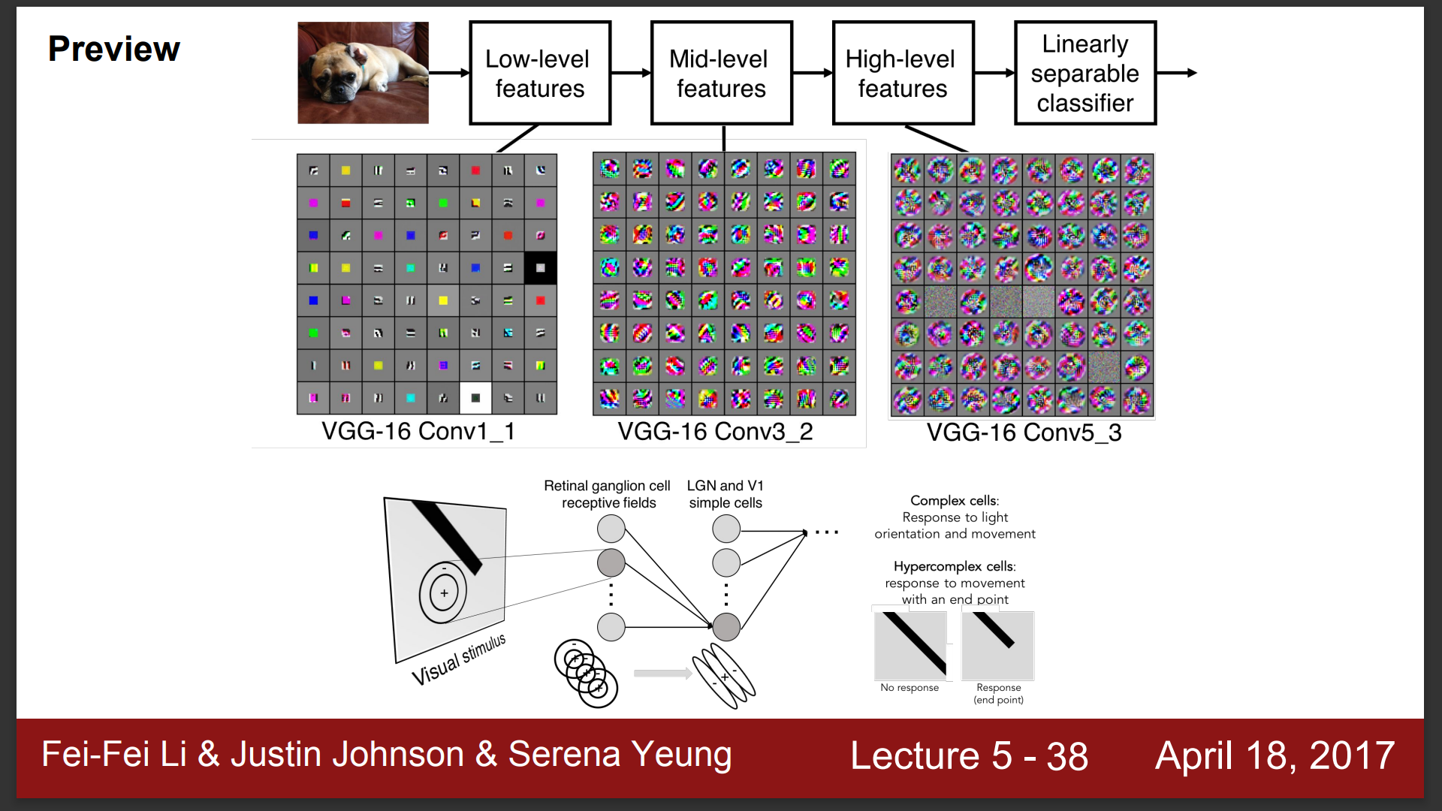

Slide 20
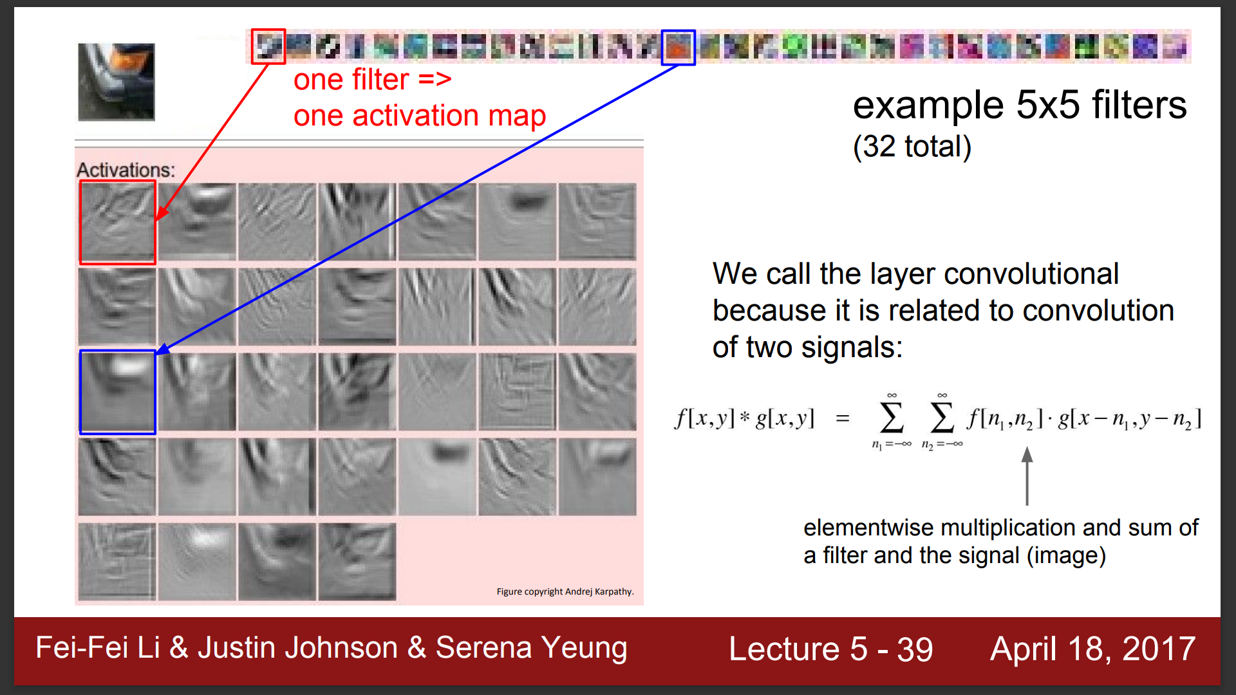

Slide 21
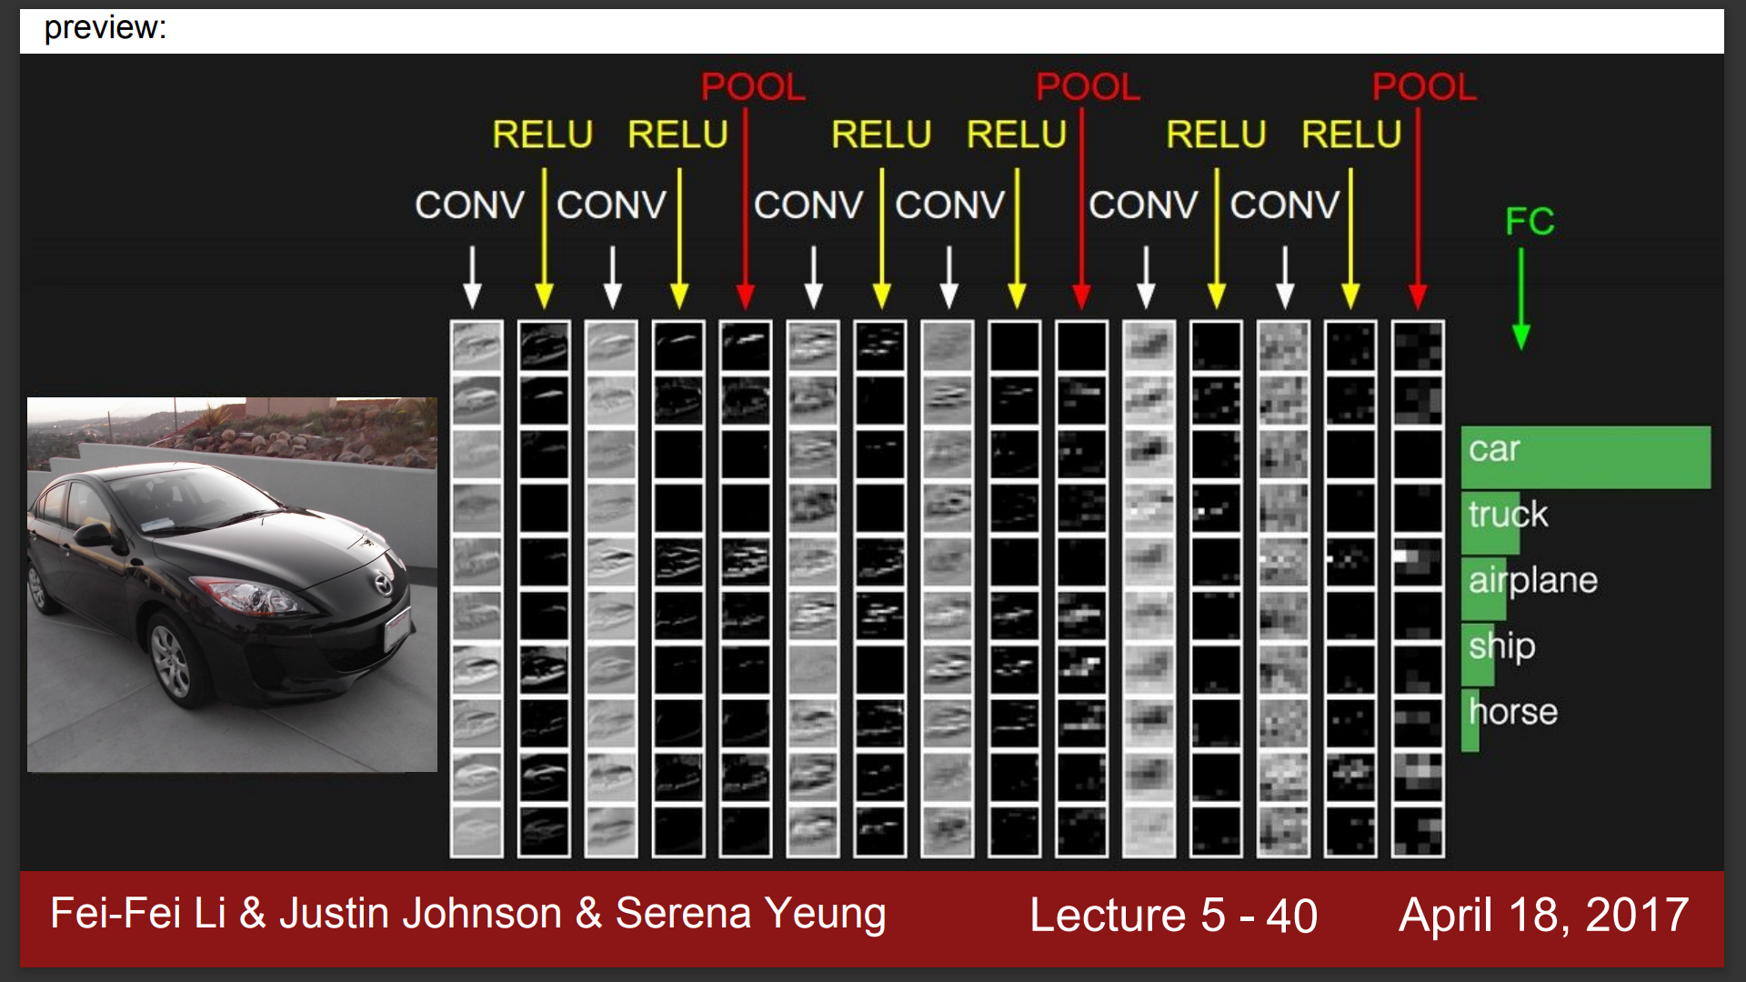

Slide 22
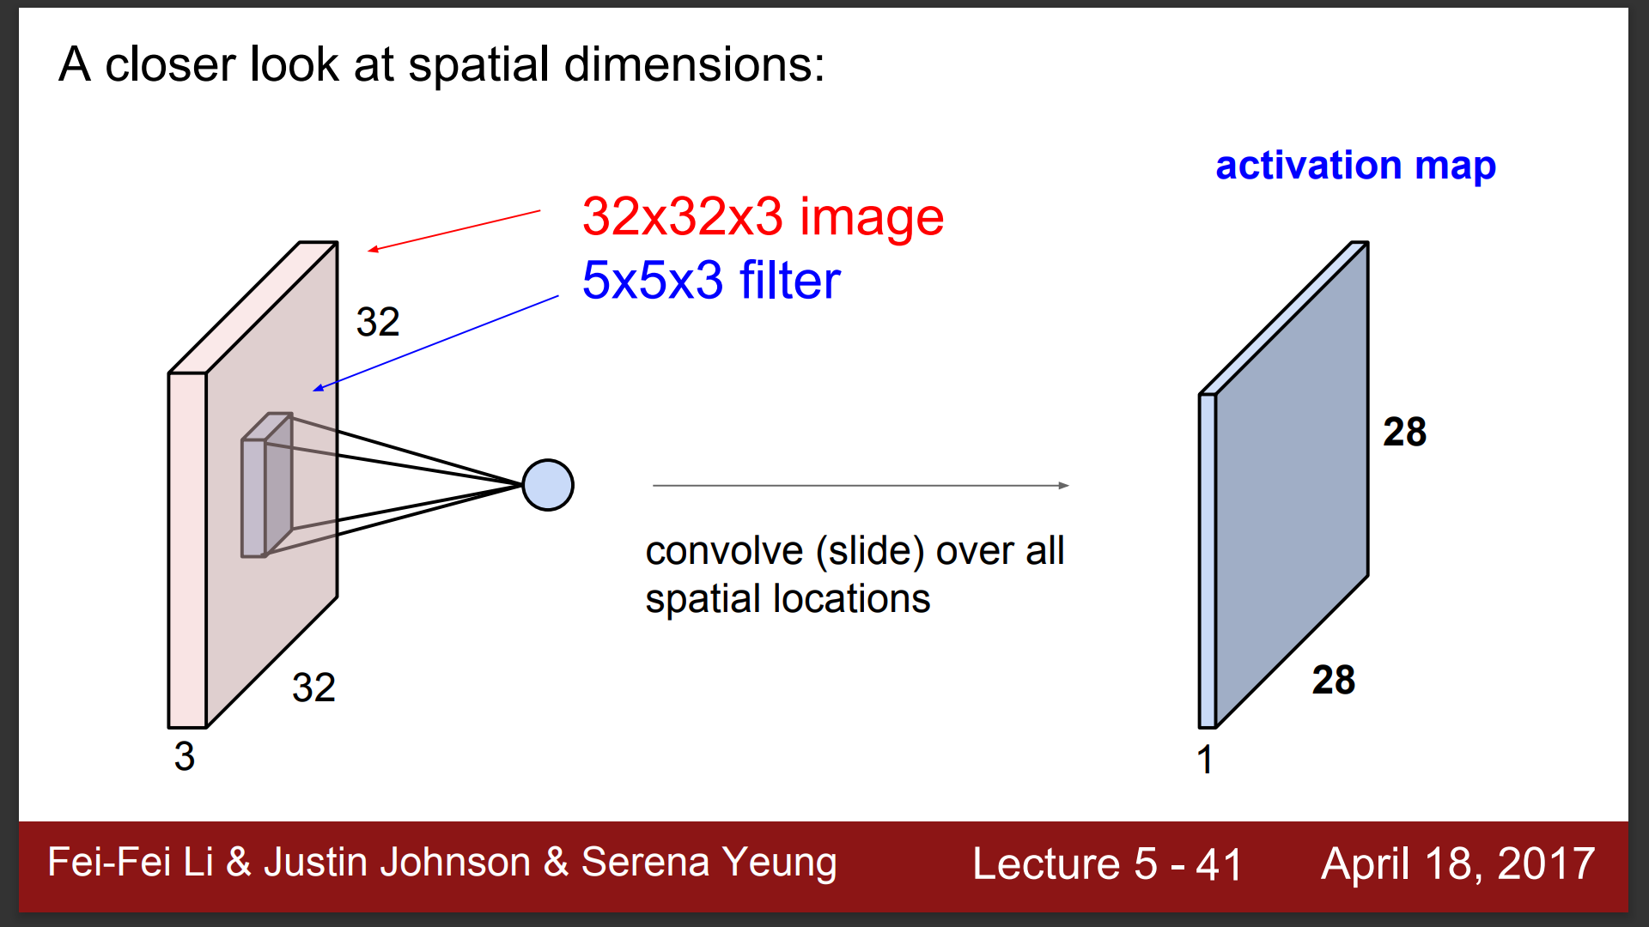

Slide 23
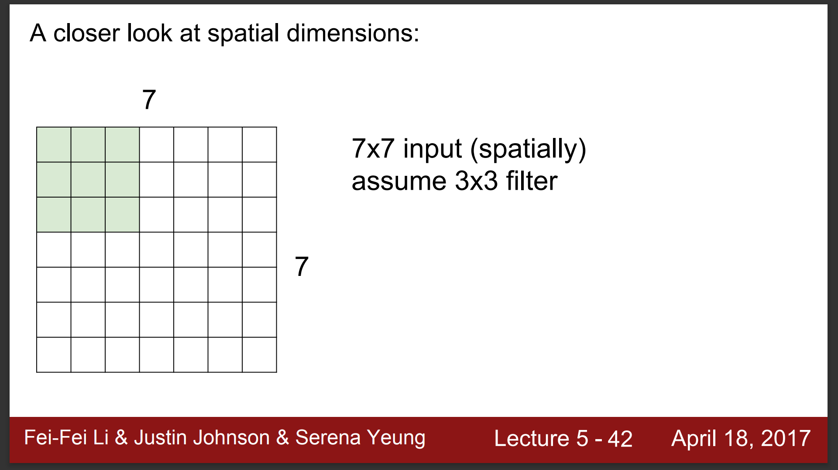

Slide 24
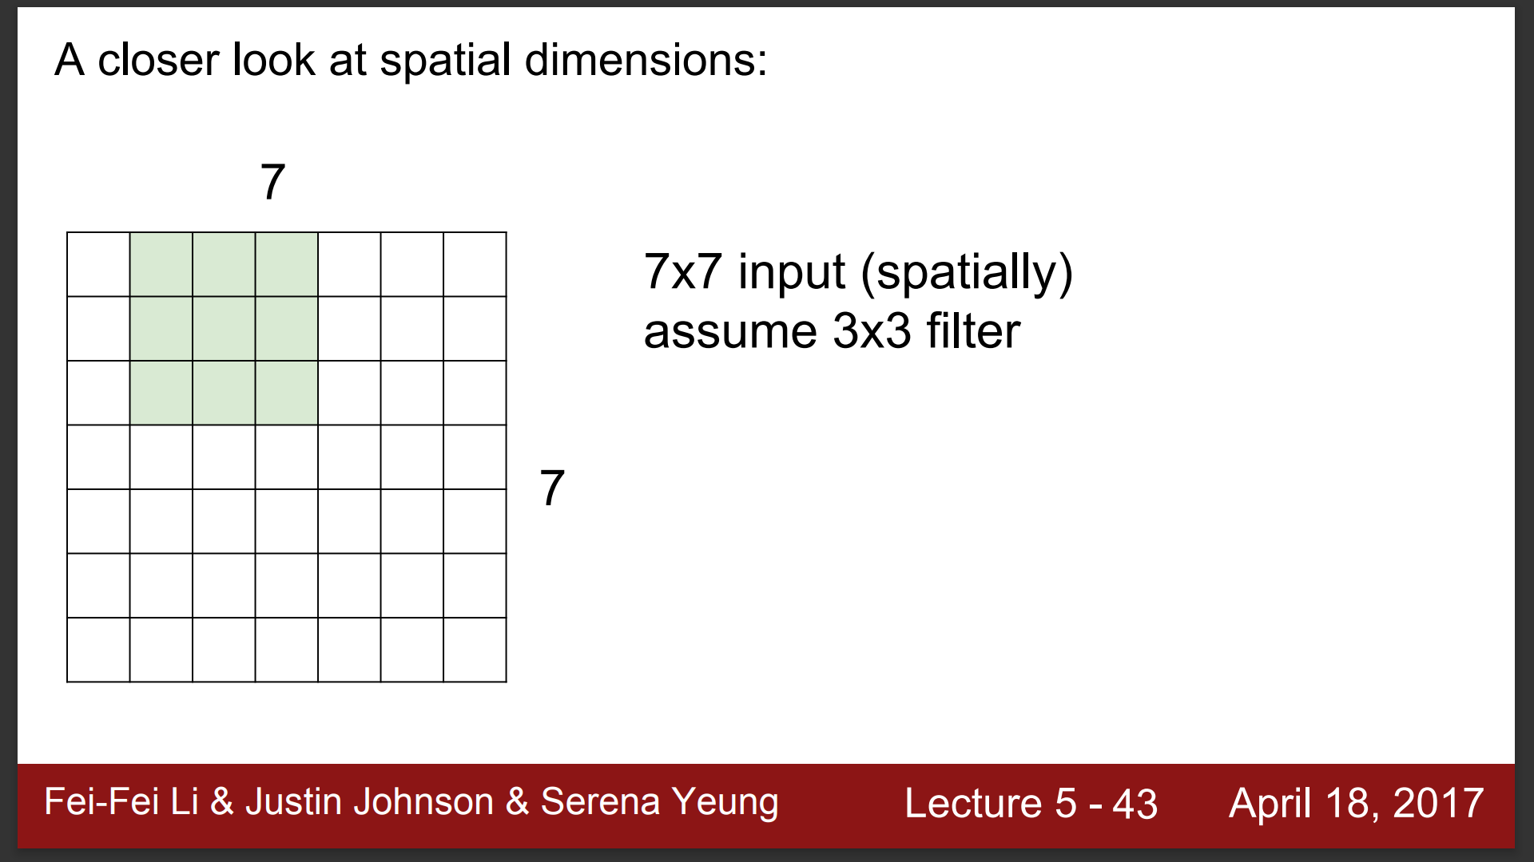

Slide 25
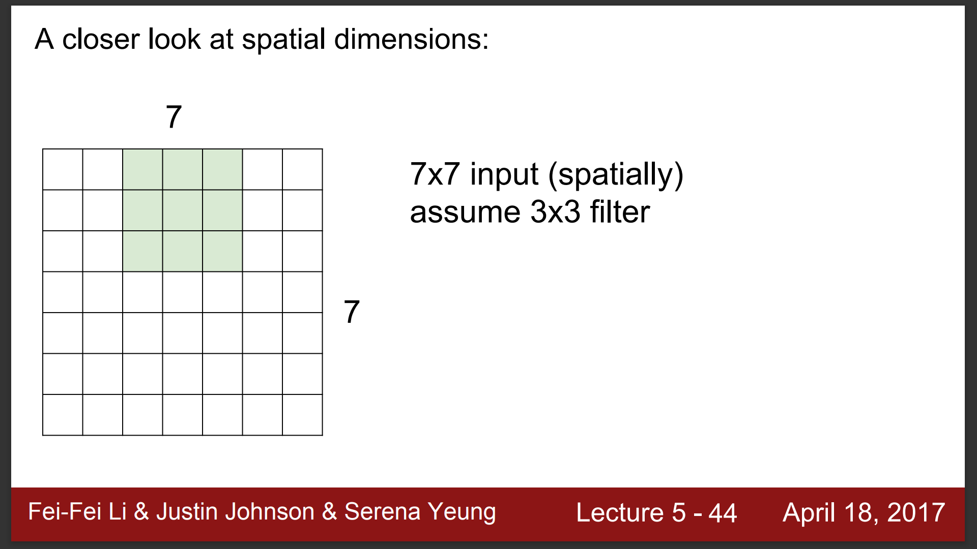

Slide 26
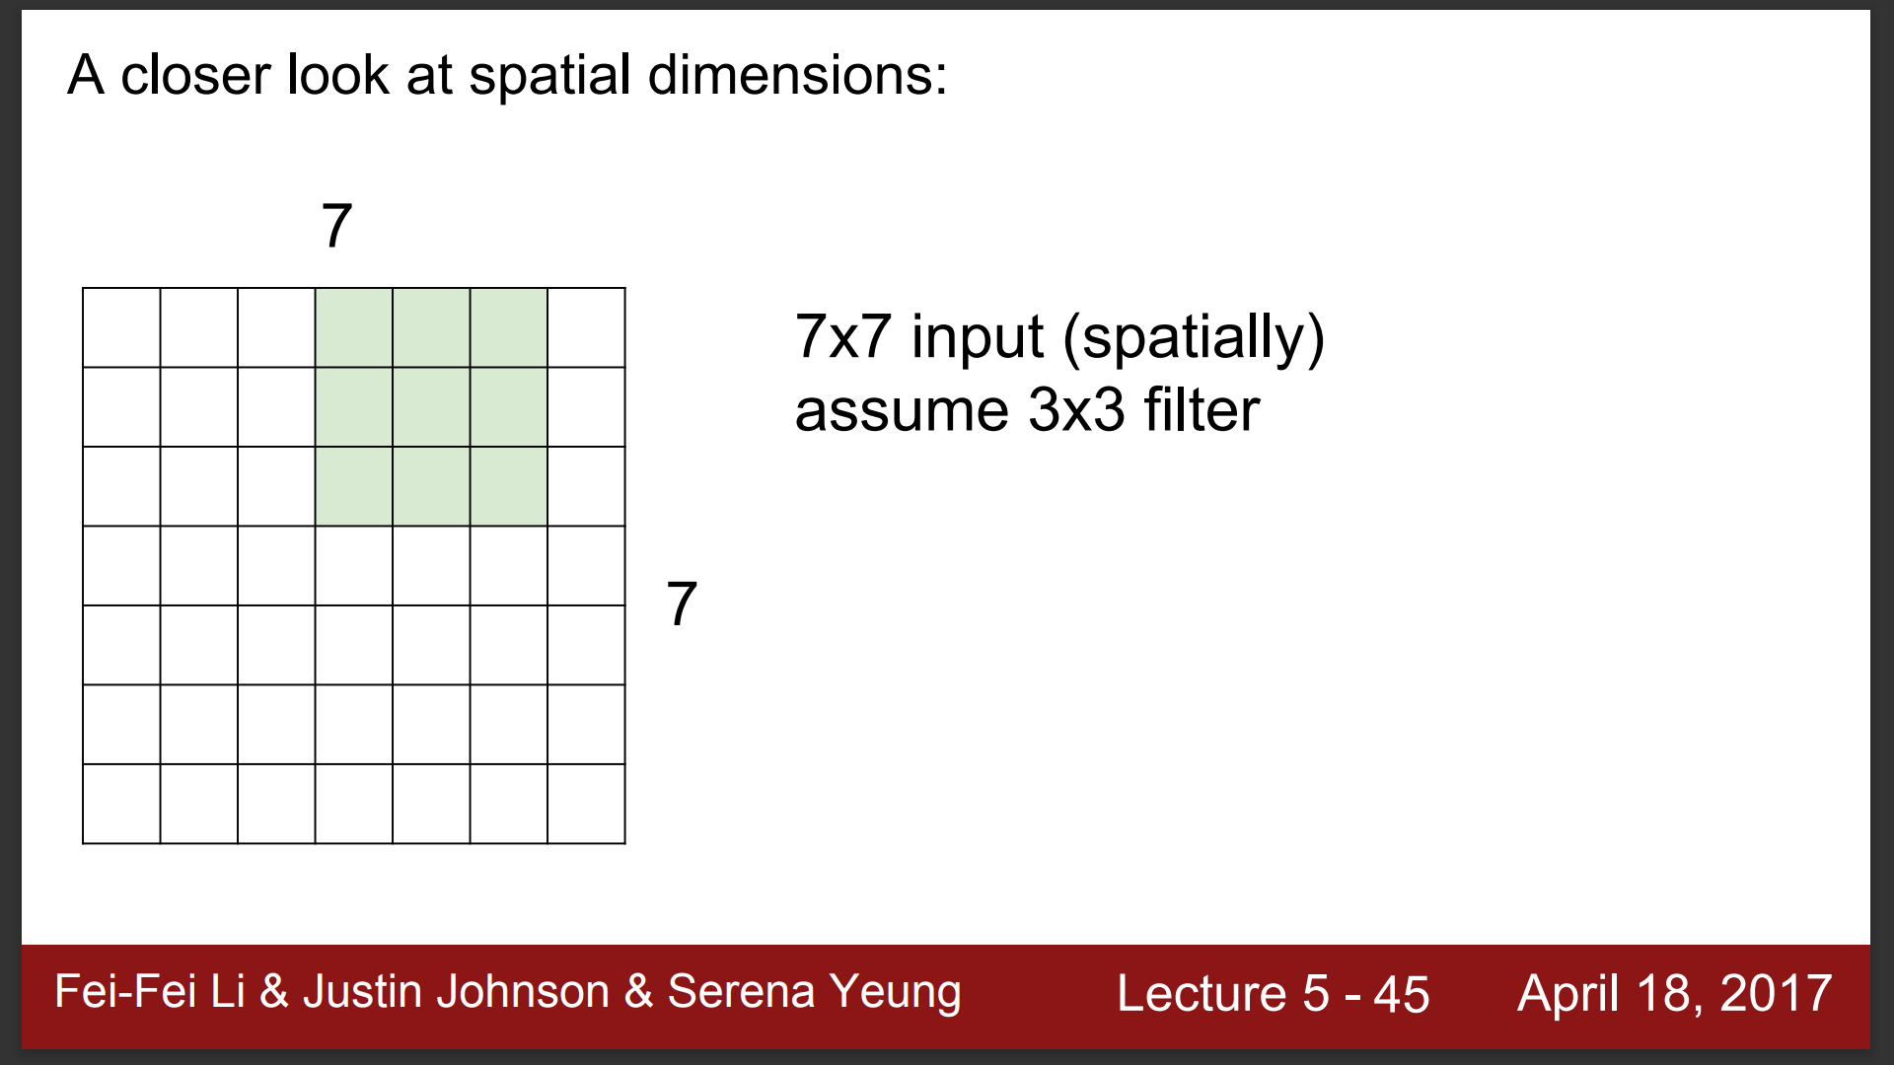

Slide 27
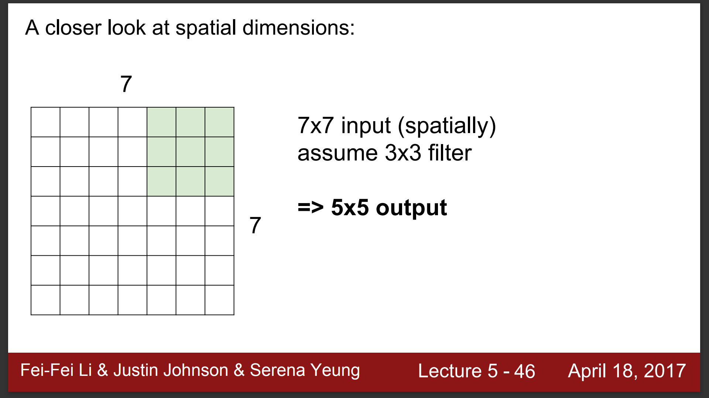

Slide 28
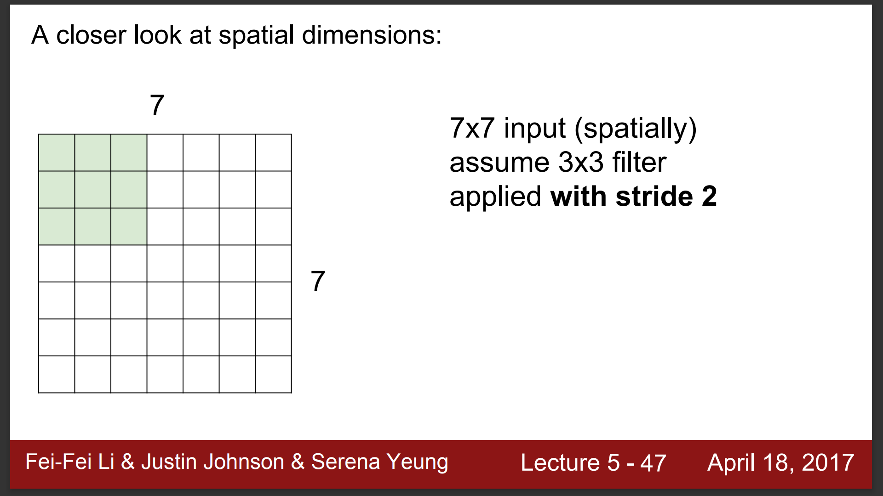

Slide 29
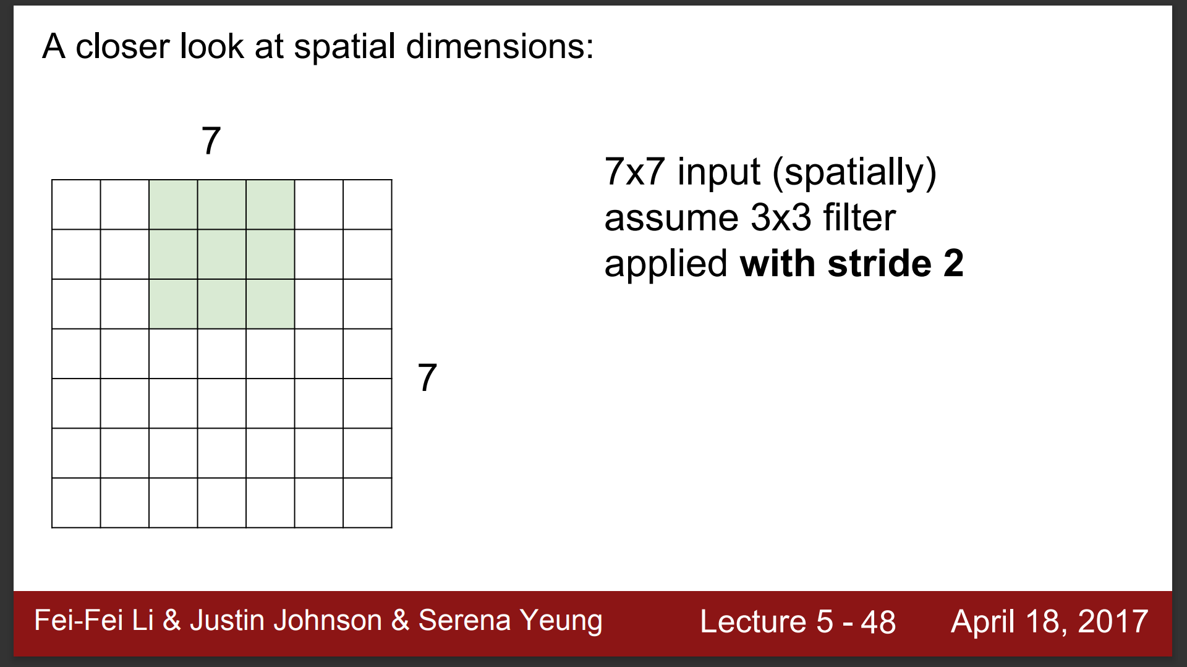

Slide 30
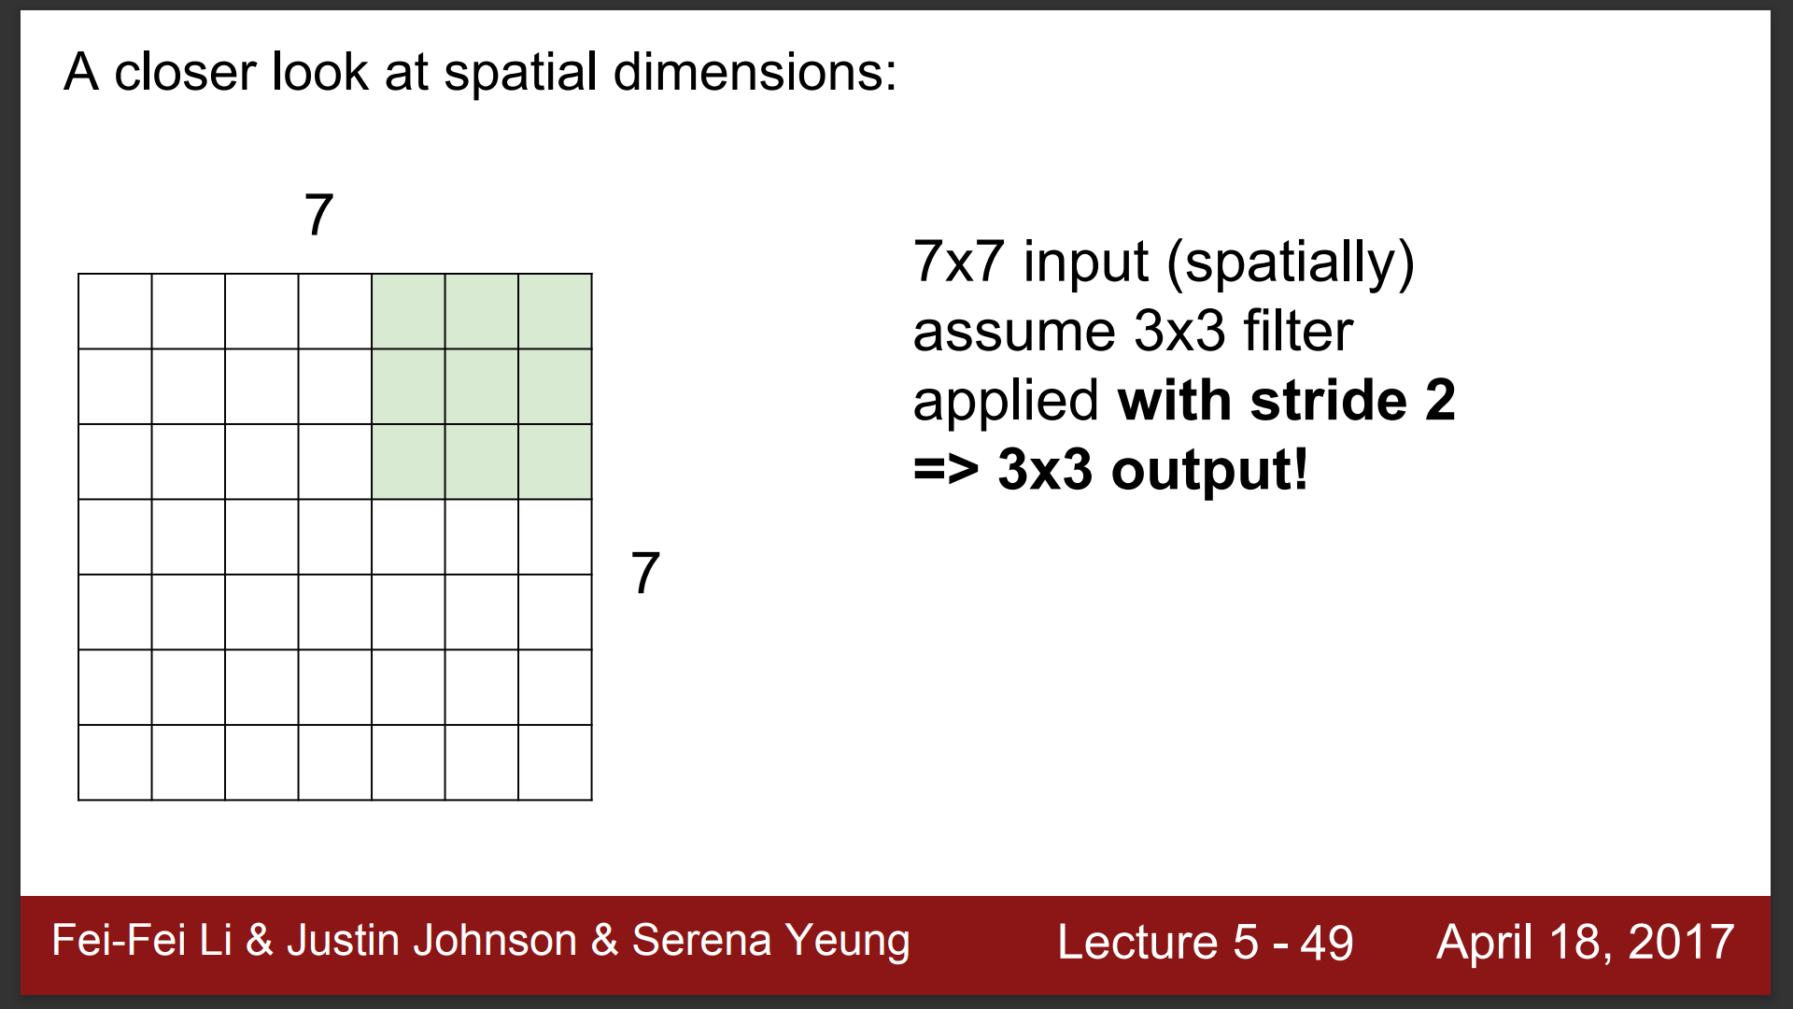

Slide 31
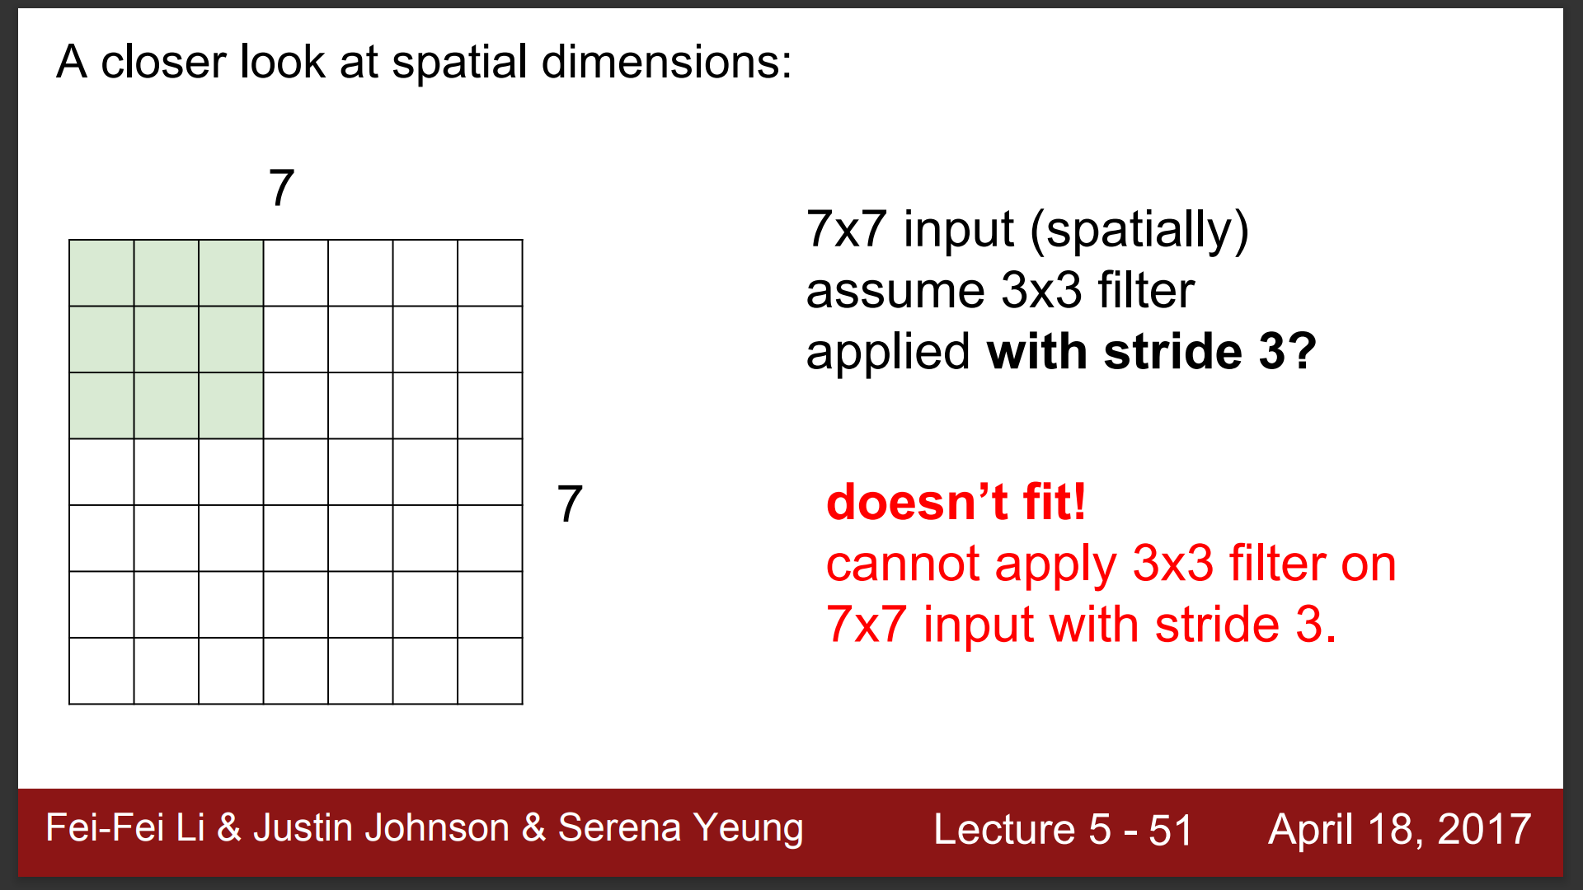

Slide 32
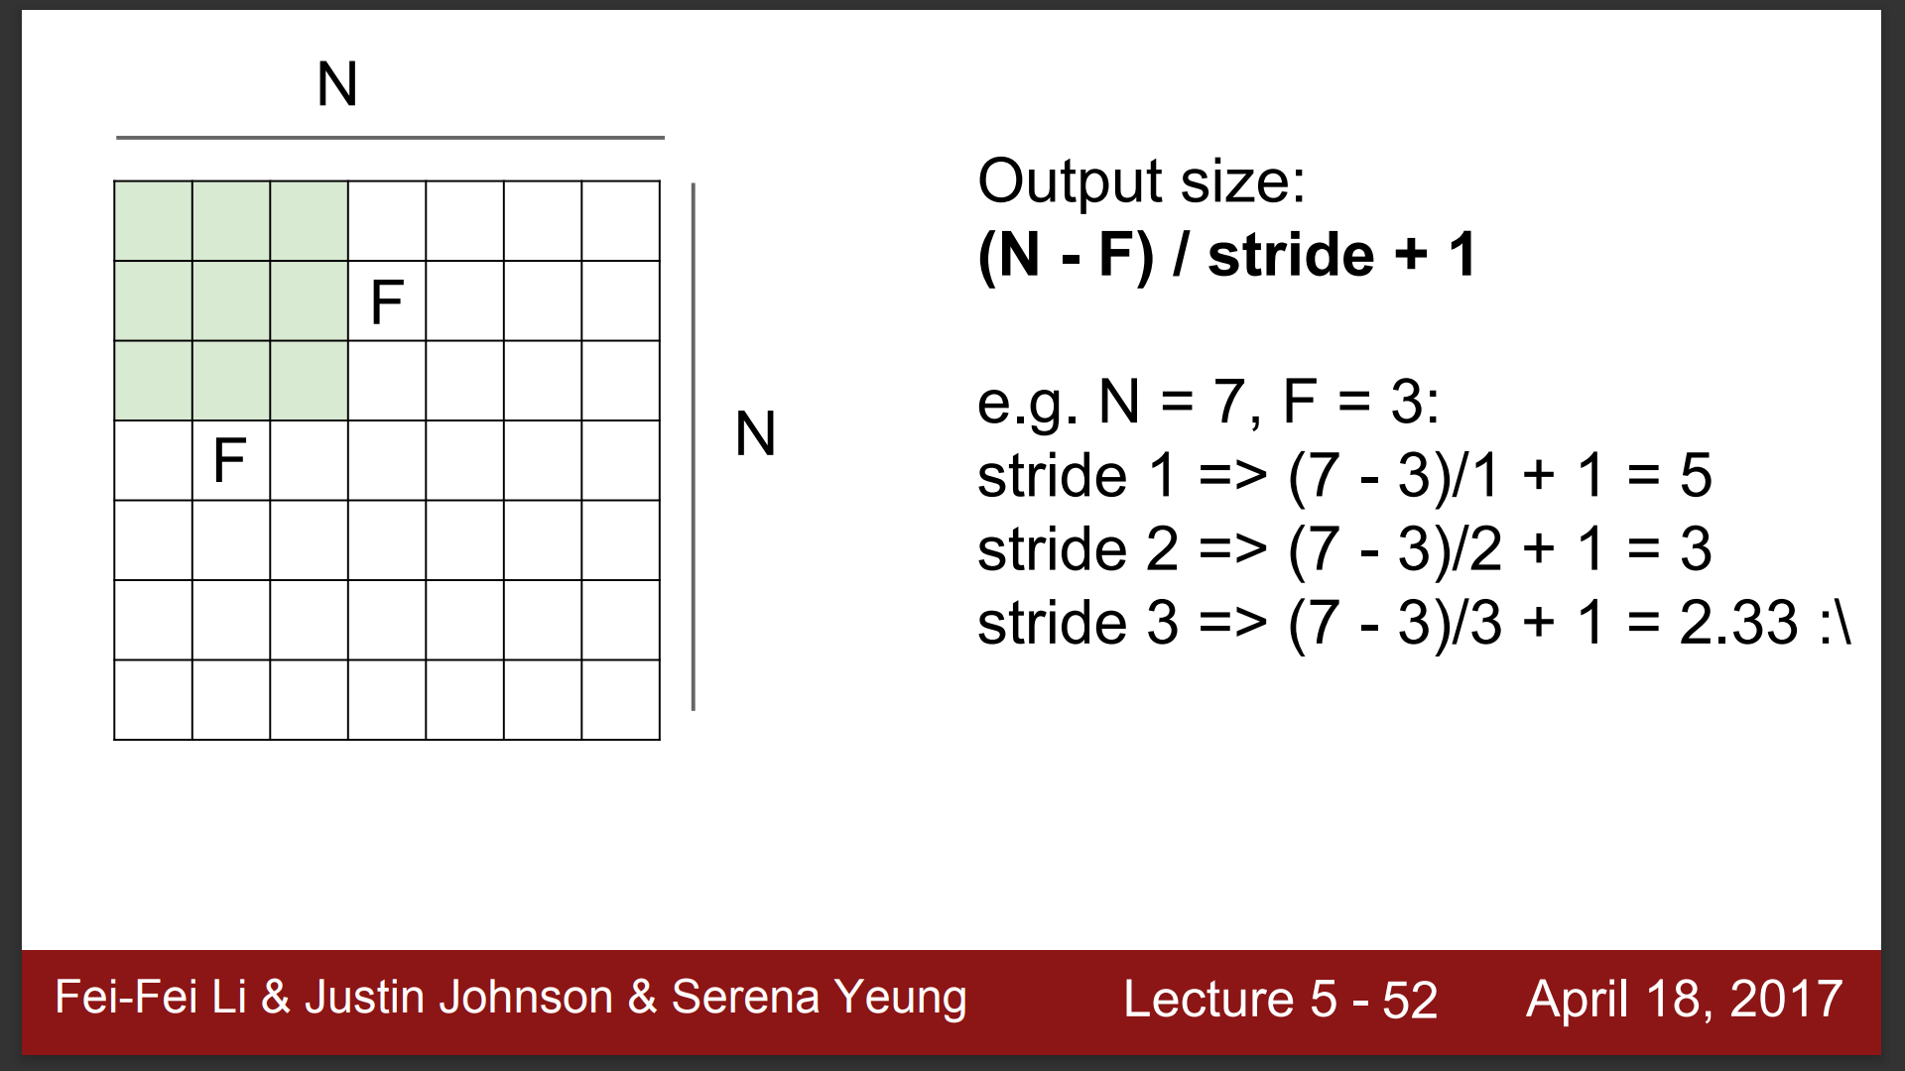

Slide 33
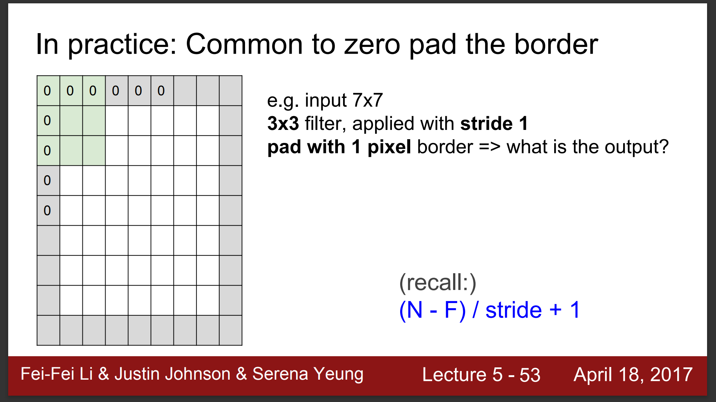

Slide 34
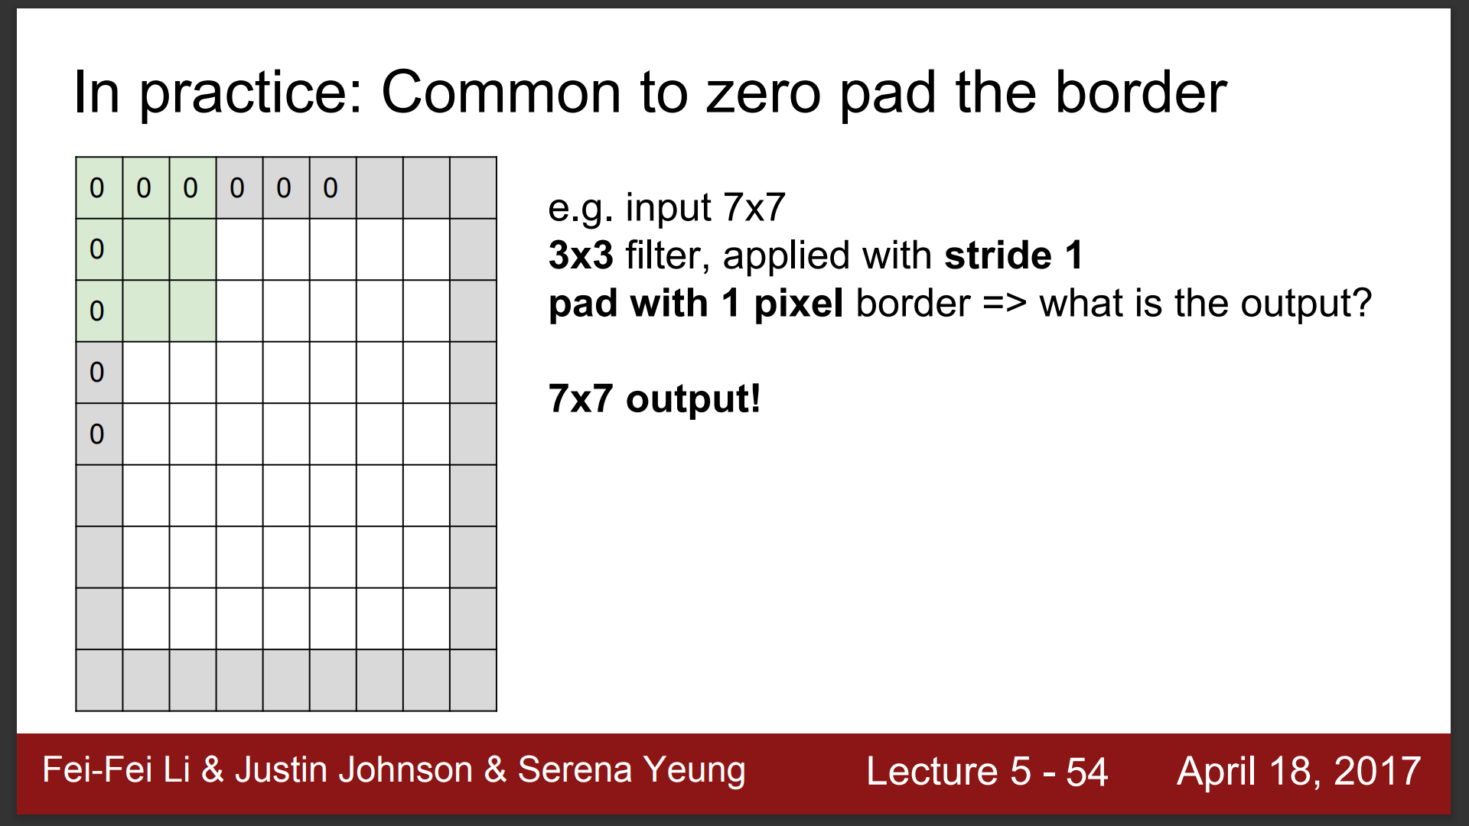

Slide 35
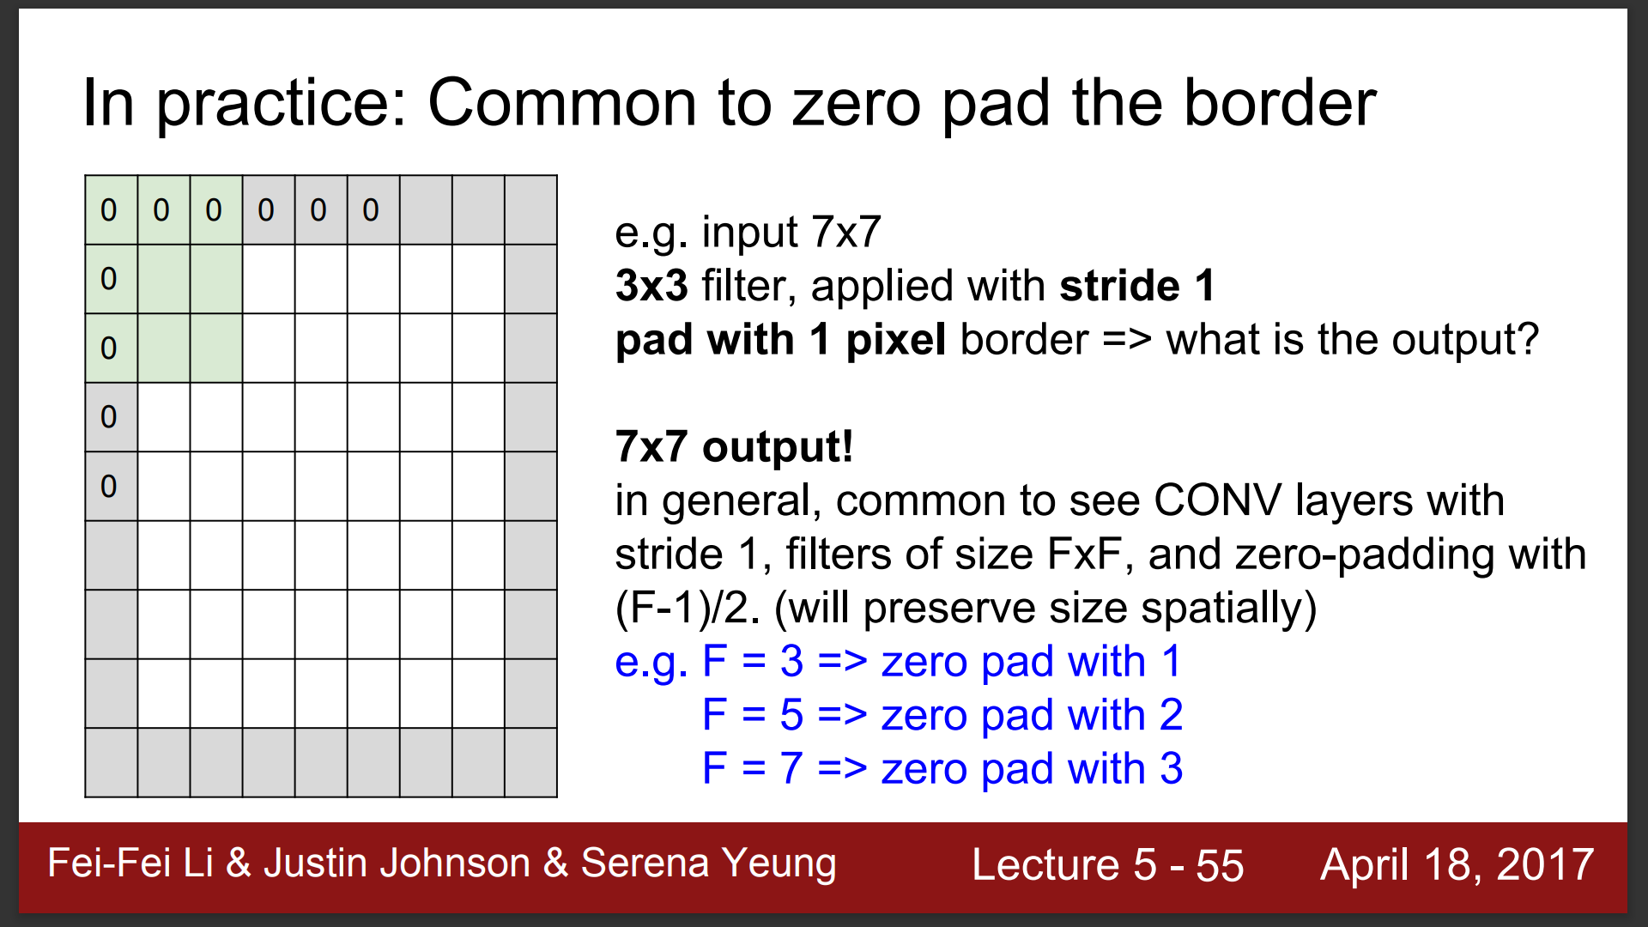

Slide 36
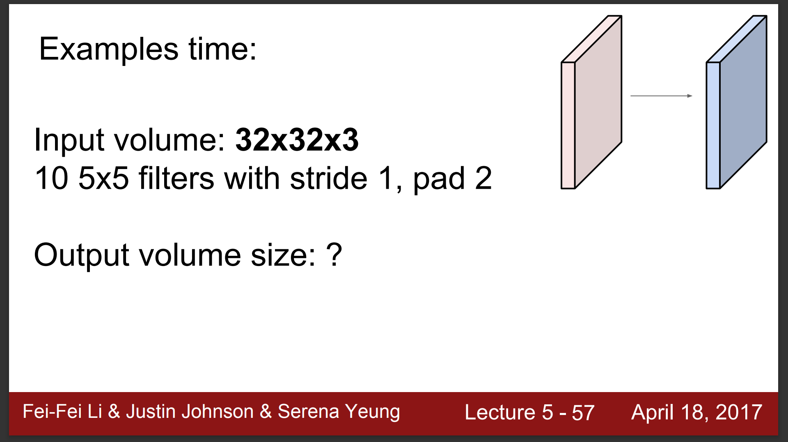

Slide 37
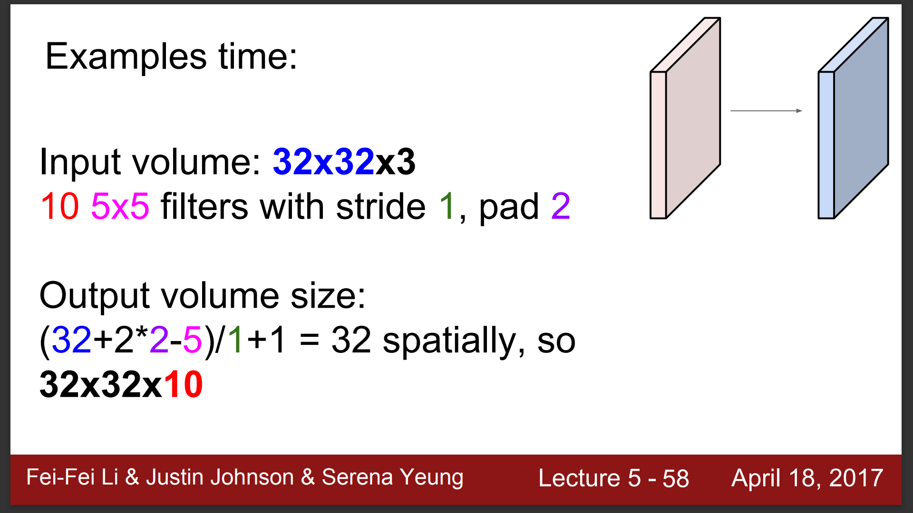

Slide 38
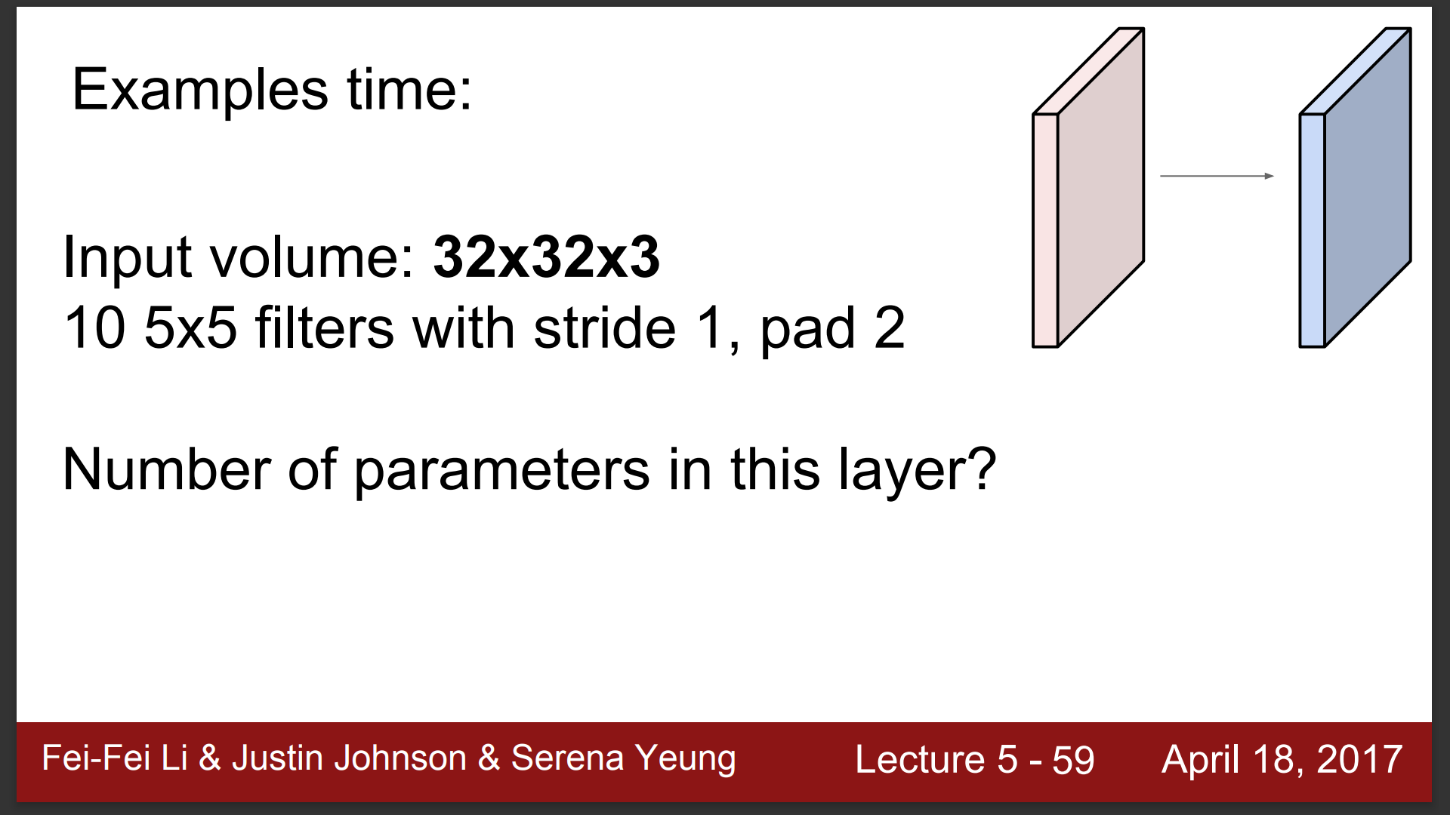

Slide 39
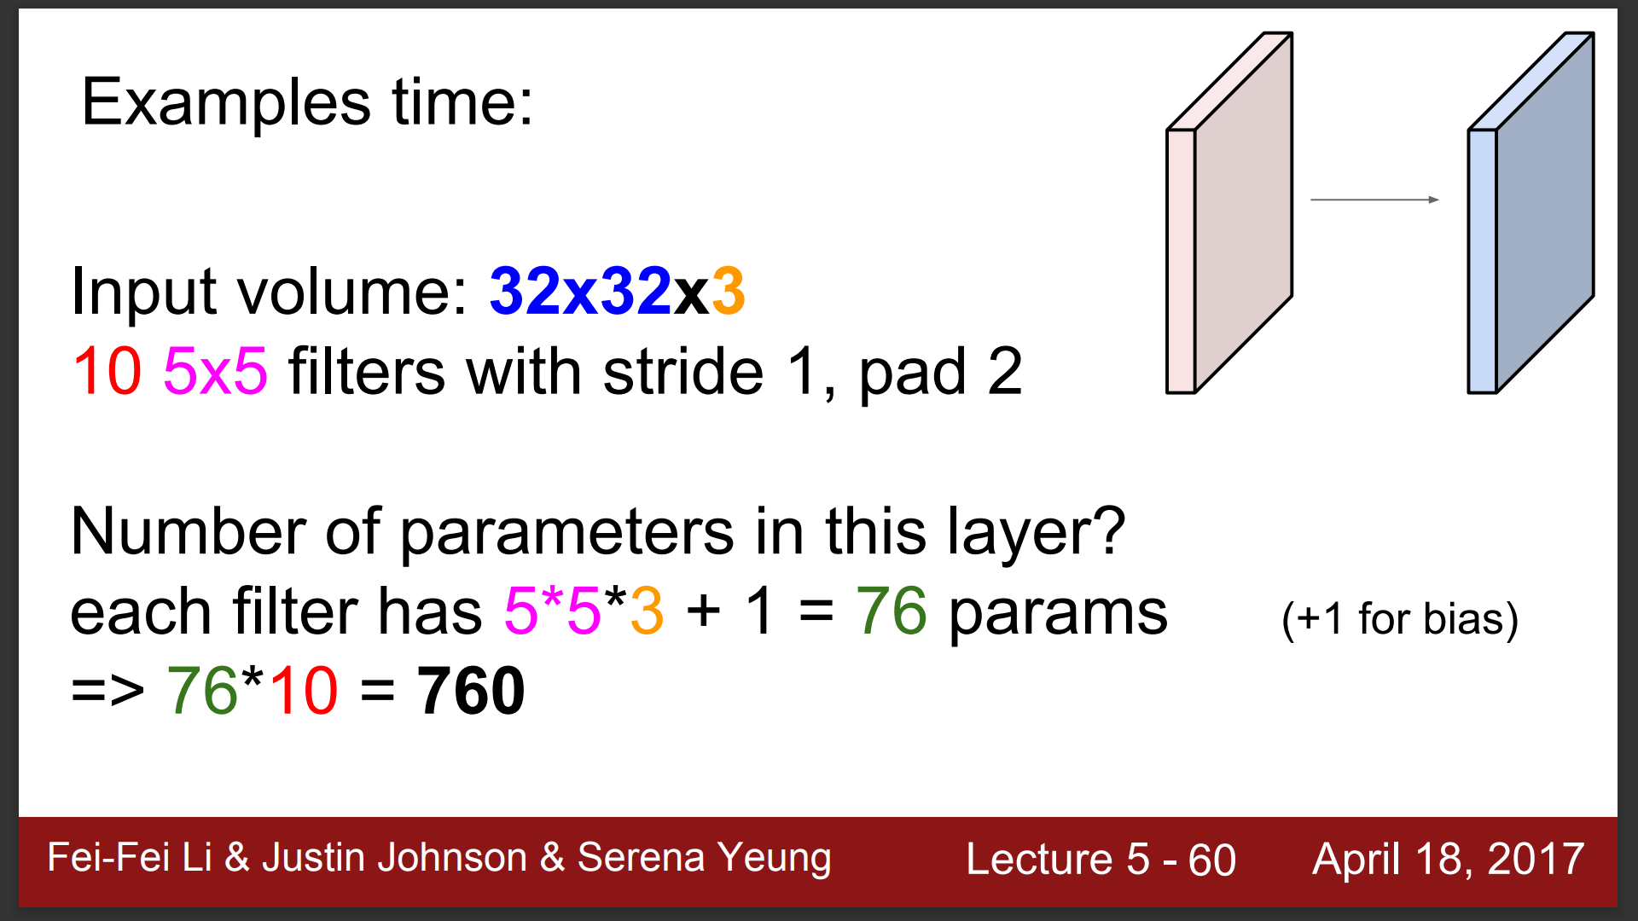

Slide 40
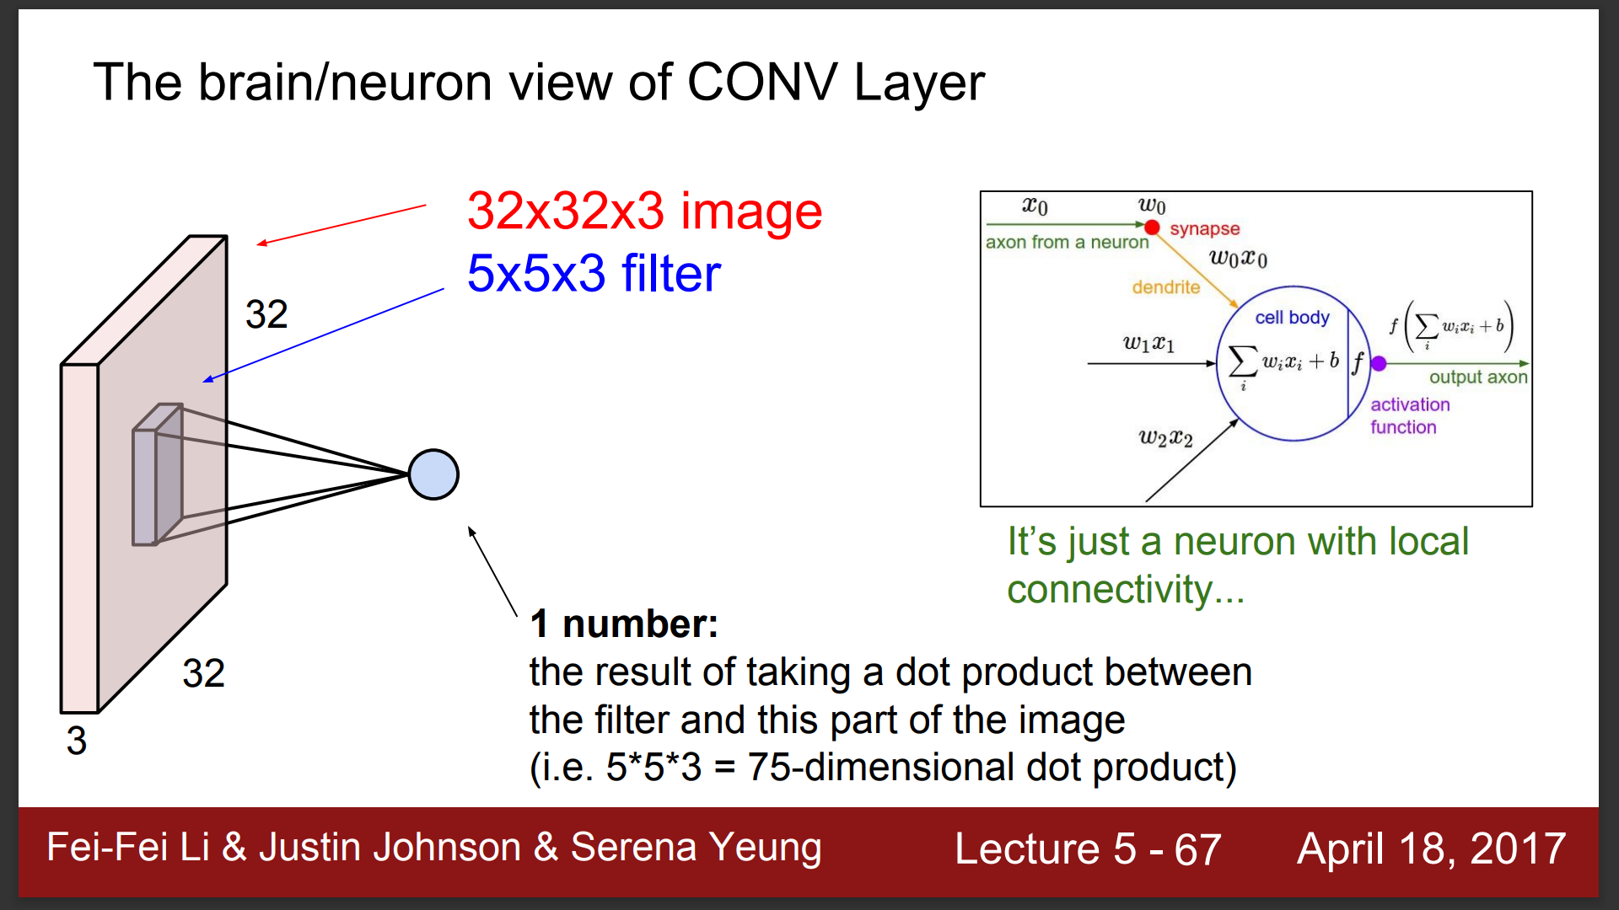

Slide 41
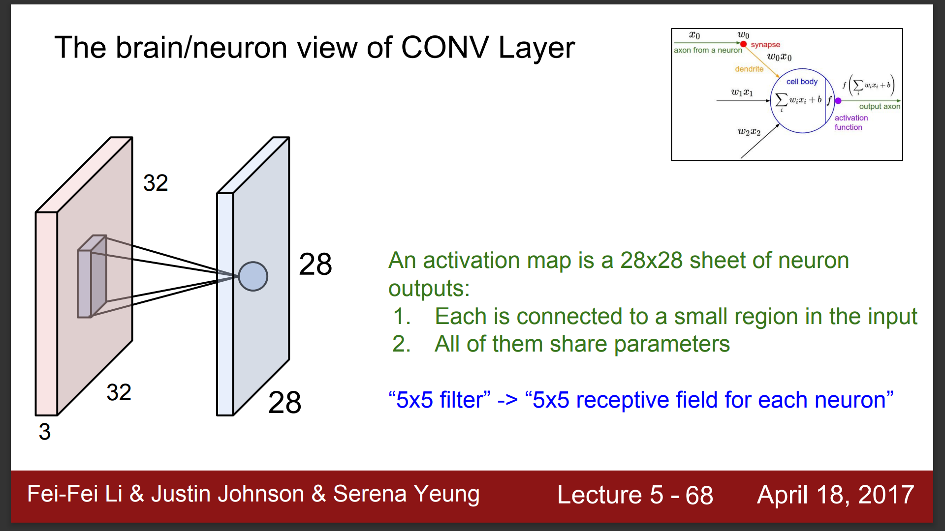

Slide 42
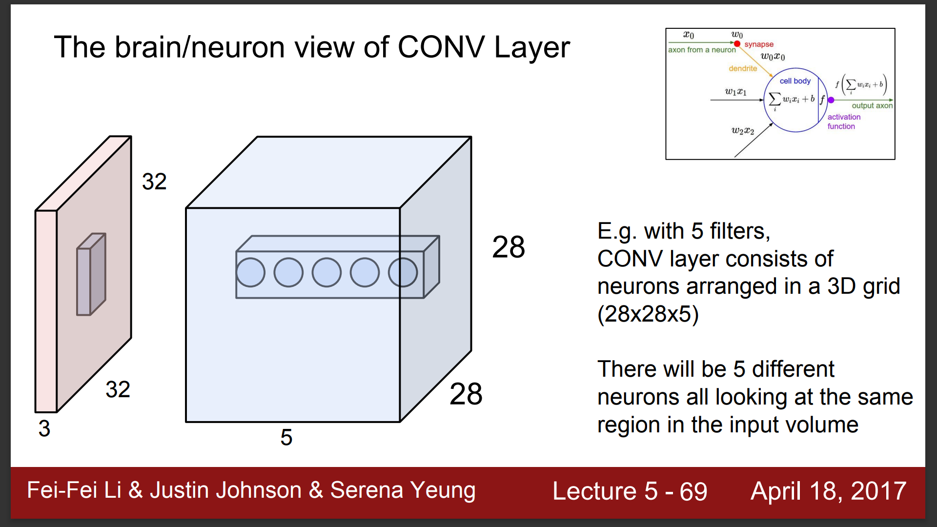

Slide 44
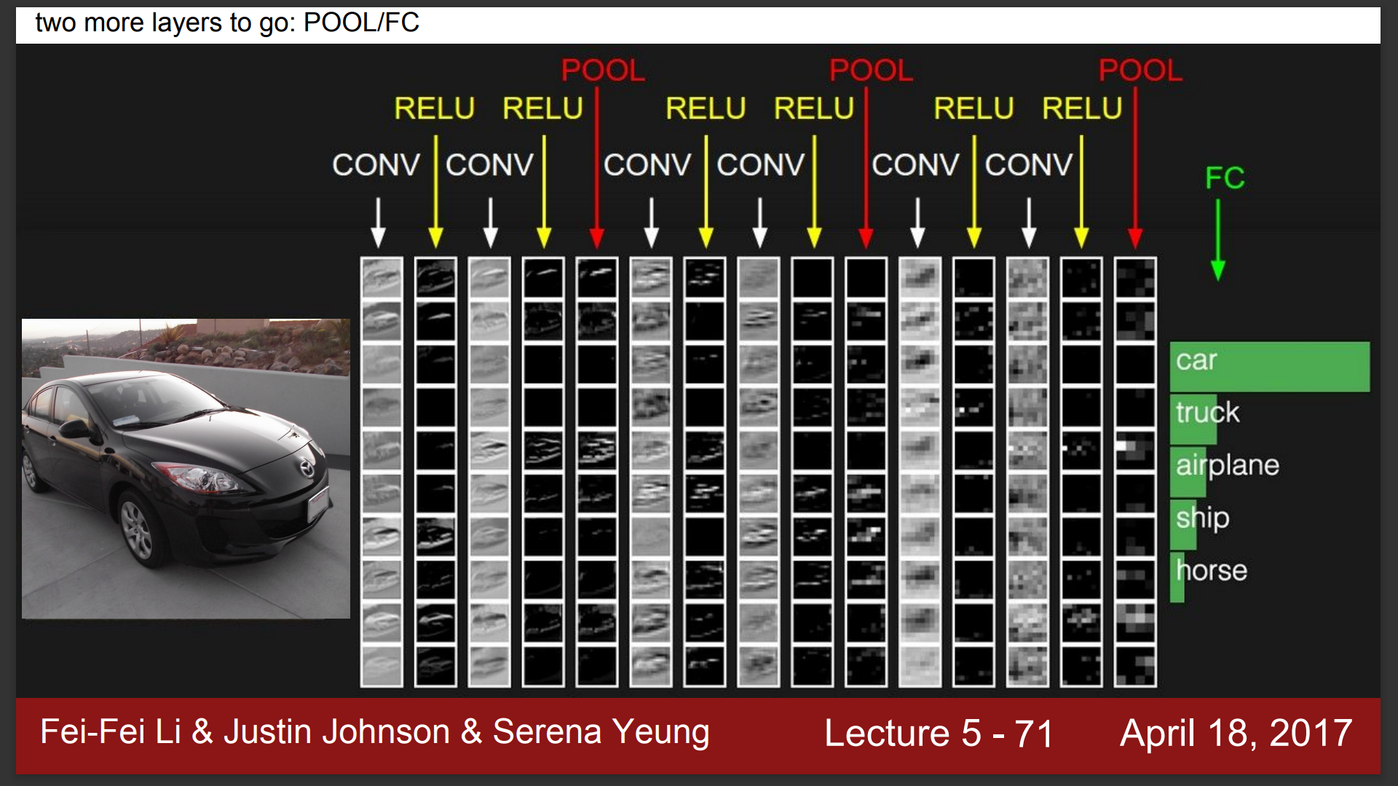

Slide 45
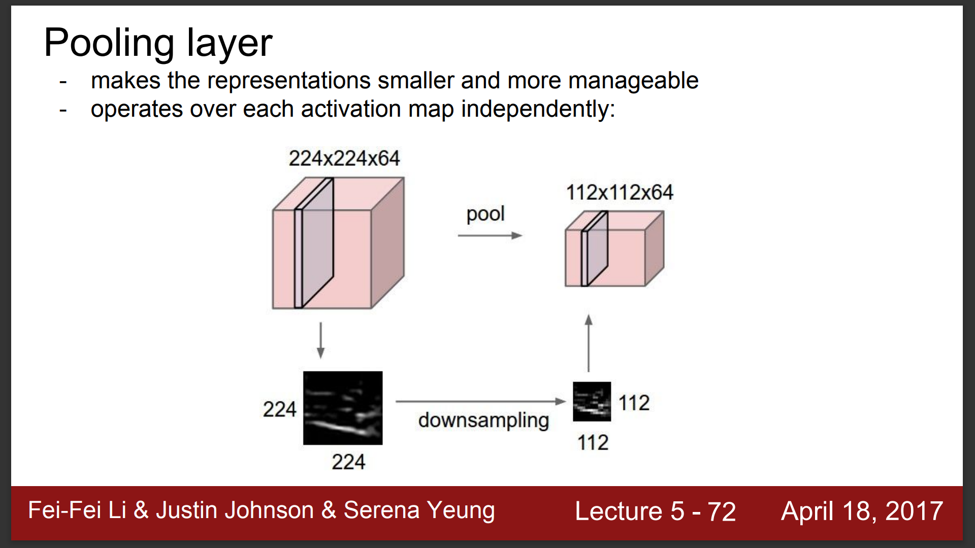

Slide 46
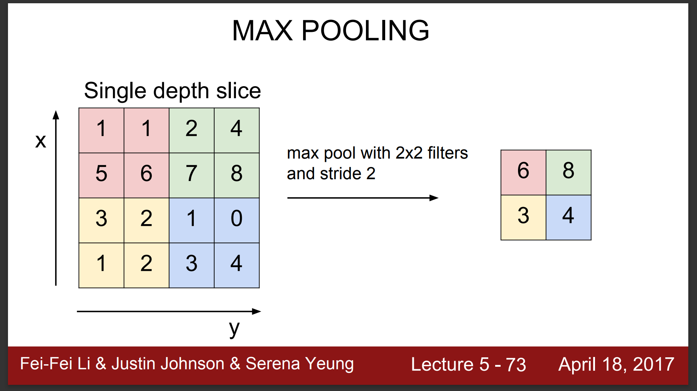

Slide 47
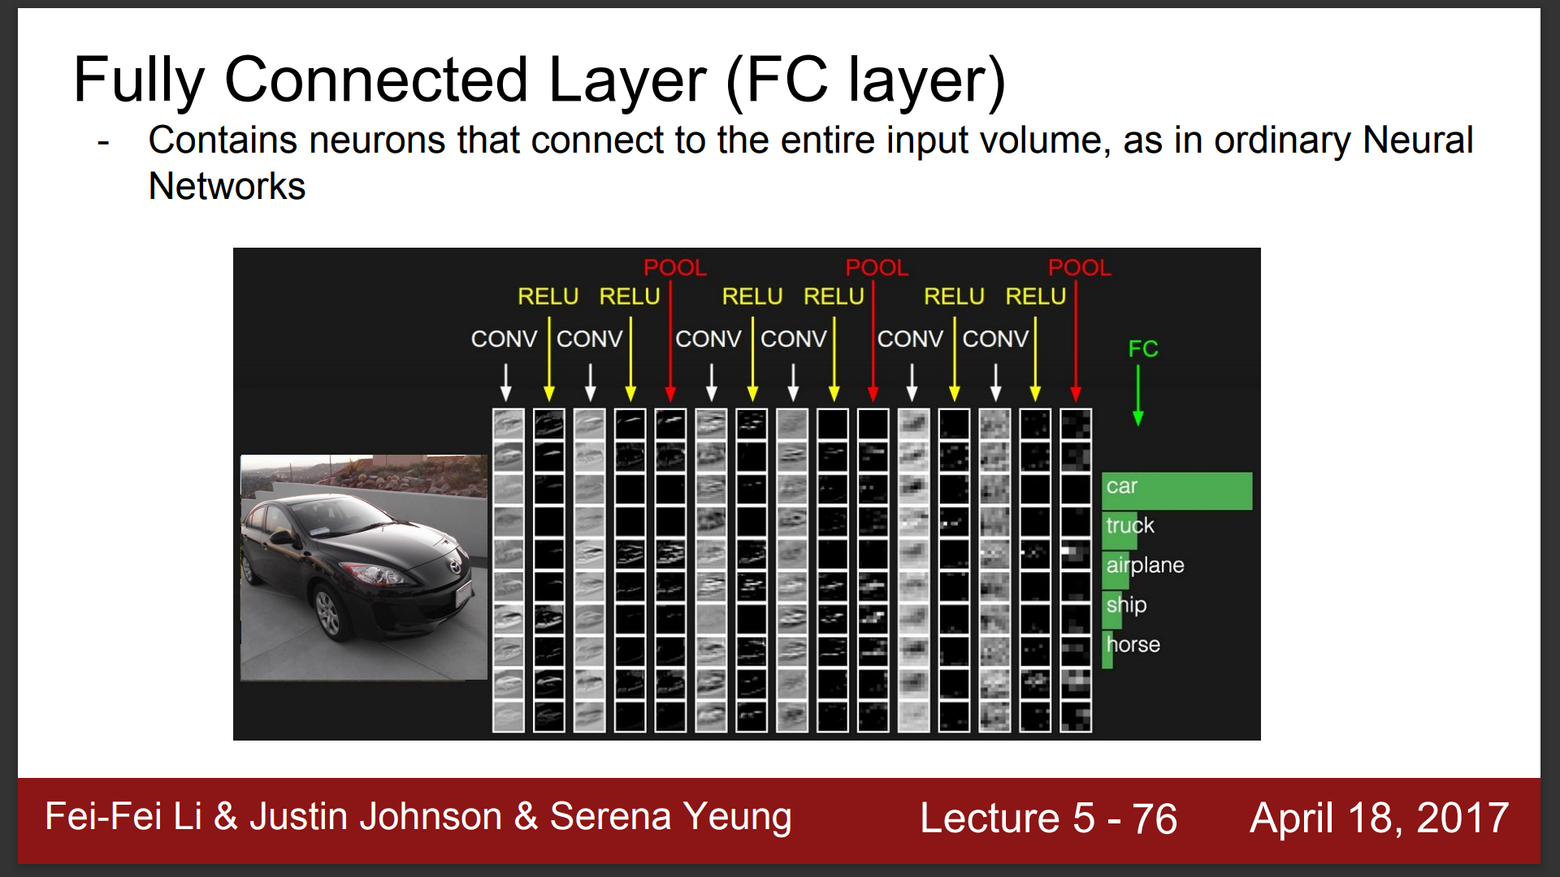

Slide 48
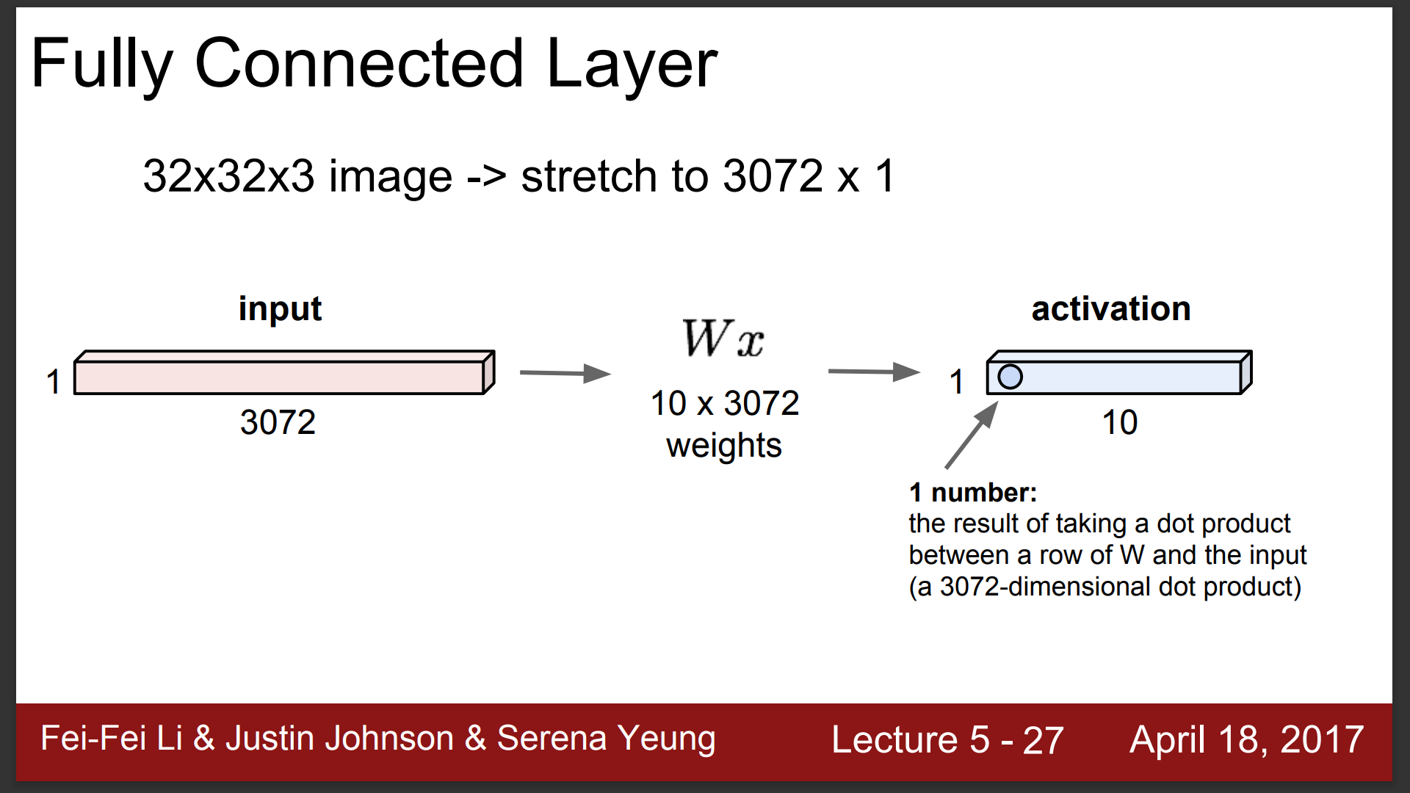

Slide 49
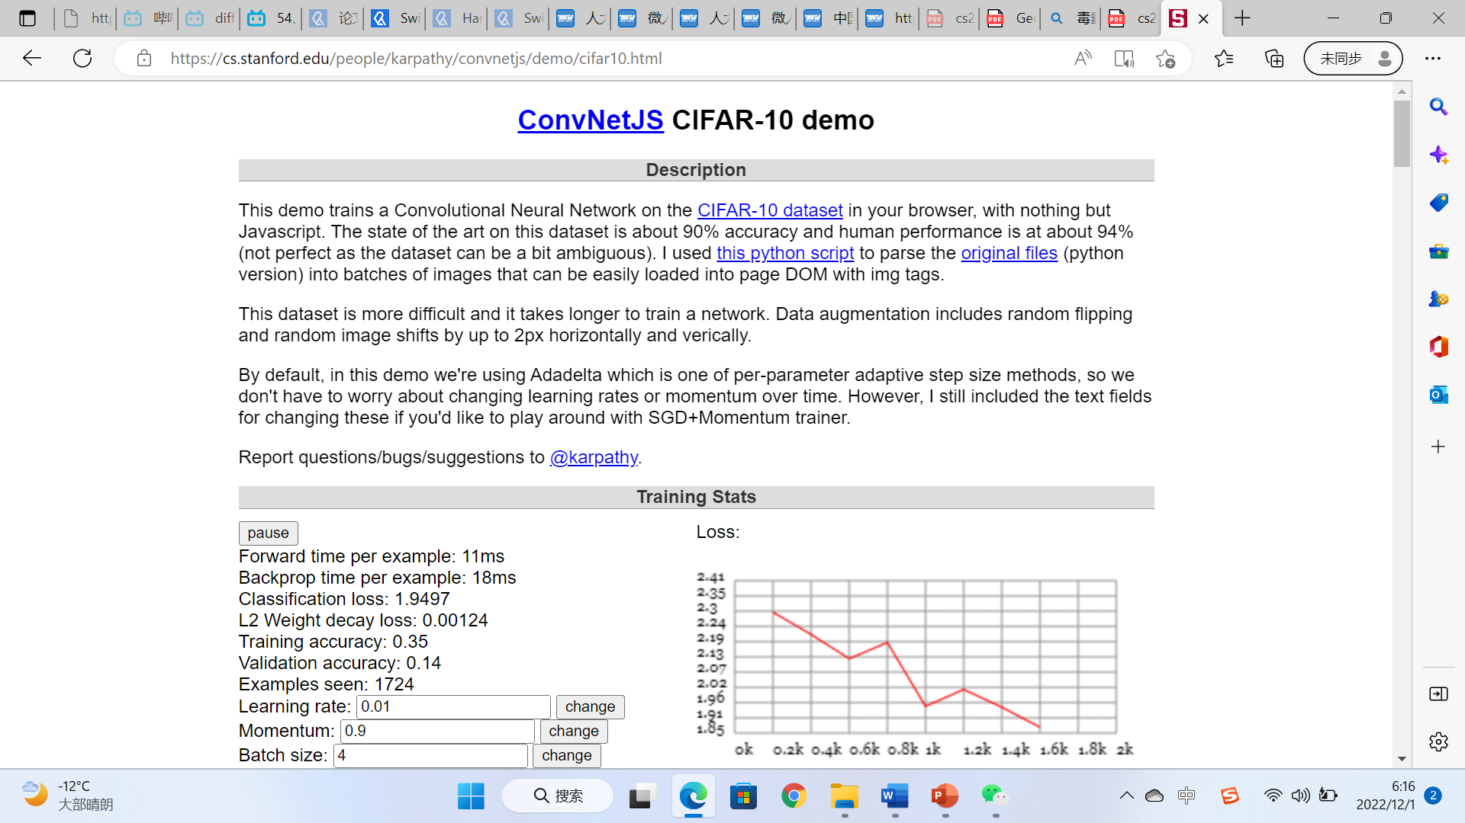

Slide 50
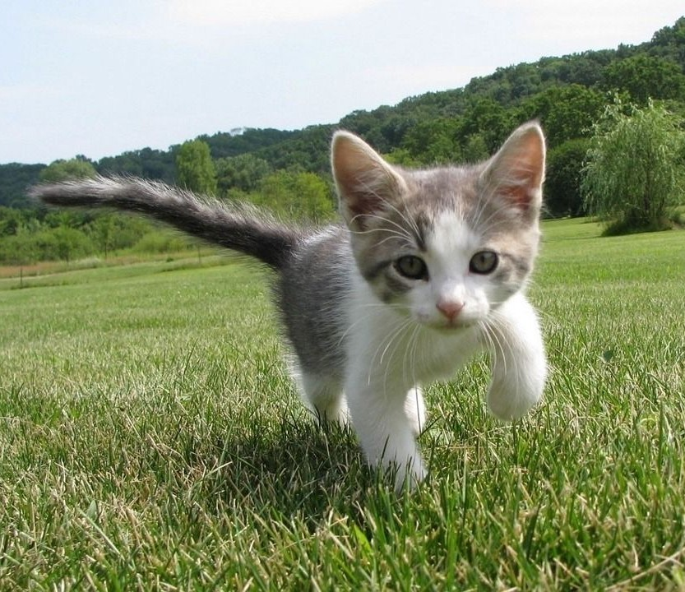

Semantic Segmentation: The Problem
?
GRASS, CAT, TREE, SKY, ...
Paired training data: for each training image, each pixel is labeled with a semantic category.
At test time, classify each pixel of a new image.
Lecture 9 -
50

Slide 51
Semantic Segmentation Idea: Sliding Window
Full image
?
Lecture 9 -
51

Slide 52
Semantic Segmentation Idea: Sliding Window
Full image
?
Impossible to classify without context
Q: how do we include context?
Lecture 9 -
52

Slide 53






Semantic Segmentation Idea: Sliding Window
Full image
Q: how do we model this?
Lecture 9 -
53

Slide 54

Semantic Segmentation Idea: Sliding Window
Classify center pixel with CNN
Extract patch
Full image
Cow
Cow
Grass
Farabet et al, “Learning Hierarchical Features for Scene Labeling,” TPAMI 2013
Pinheiro and Collobert, “Recurrent Convolutional Neural Networks for Scene Labeling”, ICML 2014
Lecture 9 -
54

Slide 55
Semantic Segmentation Idea: Sliding Window
Classify center pixel with CNN
Extract patch
Full image
Cow
Cow
Grass
Problem: Very inefficient! Not reusing shared features between overlapping patches
Farabet et al, “Learning Hierarchical Features for Scene Labeling,” TPAMI 2013
Pinheiro and Collobert, “Recurrent Convolutional Neural Networks for Scene Labeling”, ICML 2014
Lecture 9 -
10

Slide 56

Semantic Segmentation Idea: Convolution
Full image
An intuitive idea: encode the entire image with conv net, and do semantic segmentation on top.
Problem: classification architectures often reduce feature spatial sizes to go deeper, but semantic segmentation requires the output size to be the same as input size.
Lecture 9 -

Slide 57
Semantic Segmentation Idea: Fully Convolutional
Design a network with only convolutional layers without downsampling operators to make predictions for pixels all at once!
Conv
Conv
Conv
Conv
argmax
Input:
3 x H x W
Predictions: H x W
Scores: C x H x W
Convolutions: D x H x W
Lecture 9 -

Slide 58
Semantic Segmentation Idea: Fully Convolutional
Design a network with only convolutional layers without downsampling operators to make predictions for pixels all at once!
Conv
Conv
Conv
Conv
argmax
Input:
3 x H x W
Predictions: H x W
Scores: C x H x W
Convolutions: D x H x W
Problem: convolutions at original image resolution will be very expensive ...
Lecture 9 -

Slide 59
Semantic Segmentation Idea: Fully Convolutional
Design network as a bunch of convolutional layers, with
downsampling and upsampling inside the network!
Med-res: D₂ x H/4 x W/4
Med-res: D₂ x H/4 x W/4
Low-res: D₃ x H/4 x W/4
Input:
3 x H x W
High-res: D₁ x H/2 x W/2
High-res:
D x H/2 x W/2
C x H x W
Predictions: H x W
1
Long, Shelhamer, and Darrell, “Fully Convolutional Networks for Semantic Segmentation”, CVPR 2015
Noh et al, “Learning Deconvolution Network for Semantic Segmentation”, ICCV 2015
Lecture 9 -

Slide 60
Semantic Segmentation Idea: Fully Convolutional
Downsampling: Pooling, strided convolution
Design network as a bunch of convolutional layers, with
downsampling and upsampling inside the network!
Upsampling:
???
Med-res: D₂ x H/4 x W/4
Med-res: D₂ x H/4 x W/4
Low-res: D₃ x H/4 x W/4
Input:
3 x H x W
High-res: D₁ x H/2 x W/2
High-res:
D x H/2 x W/2
C x H x W
Predictions: H x W
1
Long, Shelhamer, and Darrell, “Fully Convolutional Networks for Semantic Segmentation”, CVPR 2015
Noh et al, “Learning Deconvolution Network for Semantic Segmentation”, ICCV 2015
Lecture 9 -

Slide 61
In-Network upsampling: “Unpooling”
Nearest Neighbor
1 | 1 | 2 | 2
1 | 1 | 2 | 2
3 | 3 | 4 | 4
3 | 3 | 4 | 4
“Bed of Nails”
1 | 0 | 2 | 0
0 | 0 | 0 | 0
3 | 0 | 4 | 0
0 | 0 | 0 | 0
1 | 2
3 | 4
1 | 2
3 | 4
Input: 2 x 2
Output: 4 x 4
Input: 2 x 2
Output: 4 x 4
Lecture 9 -

Slide 62
In-Network upsampling: “Max Unpooling”
Max Pooling
Max Unpooling Use positions from pooling layer
Remember which element was max!
1 | 2 | 6 | 3
3 | 5 | 2 | 1
1 | 2 | 2 | 1
7 | 3 | 4 | 8
0 | 0 | 2 | 0
0 | 1 | 0 | 0
0 | 0 | 0 | 0
3 | 0 | 0 | 4
5 | 6
7 | 8
…
1
2
3
4
Rest of the network
Input: 4 x 4
Output: 2 x 2
Input: 2 x 2
Output: 4 x 4
Corresponding pairs of downsampling and upsampling layers
Lecture 9 -

Slide 63
Learnable Upsampling
Recall: Normal 3 x 3 convolution, stride 1 pad 1
Input: 4 x 4
Output: 4 x 4
Lecture 9 -

Slide 64
Learnable Upsampling
Recall: Normal 3 x 3 convolution, stride 1 pad 1
Dot product between filter and input
Input: 4 x 4
Output: 4 x 4
Lecture 9 -

Slide 65
Learnable Upsampling
Recall: Normal 3 x 3 convolution, stride 1 pad 1
Dot product between filter and input
Input: 4 x 4
Output: 4 x 4
Lecture 9 -

Slide 66
Learnable Upsampling
Recall: Normal 3 x 3 convolution, stride 2 pad 1
Input: 4 x 4
Output: 2 x 2
Lecture 9 -

Slide 67
Learnable Upsampling
Recall: Normal 3 x 3 convolution, stride 2 pad 1
Dot product between filter and input
Input: 4 x 4
Output: 2 x 2
Lecture 9 -

Slide 68
Learnable Upsampling
Recall: Normal 3 x 3 convolution, stride 2 pad 1
Filter moves 2 pixels in the input for every one pixel in the output
Dot product between filter and input
Stride gives ratio between movement in input and output
We can interpret strided convolution as “learnable downsampling”.
Input: 4 x 4
Output: 2 x 2
Lecture 9 -

Slide 69
Learnable Upsampling: Transposed Convolution
3 x 3 transposed convolution, stride 2 pad 1
Input: 2 x 2
Output: 4 x 4
Lecture 9 -

Slide 70
Learnable Upsampling: Transposed Convolution
3 x 3 transposed convolution, stride 2 pad 1
Input gives weight for filter
Input: 2 x 2
Output: 4 x 4
Lecture 9 -

Slide 71
Learnable Upsampling: Transposed Convolution
3 x 3 transposed convolution, stride 2 pad 1
Filter moves 2 pixels in the output for every one pixel in the input
Input gives weight for filter
Stride gives ratio between movement in output and input
Input: 2 x 2
Output: 4 x 4
Lecture 9 -

Slide 72
Learnable Upsampling: Transposed Convolution
3 x 3 transposed convolution, stride 2 pad 1
Sum where output overlaps
Filter moves 2 pixels in the output for every one pixel in the input
Input gives weight for filter
Stride gives ratio between movement in output and input
Input: 2 x 2
Output: 4 x 4
Lecture 9 -

Slide 73
Learnable Upsampling: Transposed Convolution
3 x 3 transposed convolution, stride 2 pad 1
Sum where output overlaps
Q: Why is it called transposed convolution?
Filter moves 2 pixels in the output for every one pixel in the input
Input gives weight for filter
Stride gives ratio between movement in output and input
Input: 2 x 2
Output: 4 x 4
Lecture 9 -

Slide 74
Learnable Upsampling: 1D Example
Output
Input
Filter
 | ax
 | ay
 | az
 |  | + | bx
 |  |  | by
 |  |  | bz
Output contains copies of the filter weighted by the input, summing at where at overlaps in the output
x
y
z
a
b
Lecture 9 -

Slide 75


Convolution as Matrix Multiplication (1D Example)
We can express convolution in terms of a matrix multiplication
Example: 1D conv, kernel size=3, stride=2, padding=1
Lecture 9 -

Slide 76


Convolution as Matrix Multiplication (1D Example)
We can express convolution in terms of a matrix multiplication
Transposed convolution multiplies by the transpose of the same matrix:
Example: 1D conv, kernel size=3, stride=2, padding=1
Example: 1D transposed conv, kernel size=3, stride=2, padding=0
Lecture 9 -

Slide 77
Semantic Segmentation Idea: Fully Convolutional
Design network as a bunch of convolutional layers, with
downsampling and upsampling inside the network!
Upsampling:
Downsampling: Pooling, strided convolution
Unpooling or strided transposed convolution
Med-res: D₂ x H/4 x W/4
Med-res: D₂ x H/4 x W/4
Low-res: D₃ x H/4 x W/4
Input:
3 x H x W
High-res: D₁ x H/2 x W/2
High-res: D₁ x H/2 x W/2
Predictions: H x W
Long, Shelhamer, and Darrell, “Fully Convolutional Networks for Semantic Segmentation”, CVPR 2015 Noh et al, “Learning Deconvolution Network for Semantic Segmentation”, ICCV 2015
Lecture 9 -

Slide 78
Semantic Segmentation: Summary
Lecture 9 -

Slide 79
人工智能与视觉
视觉信息的获取方法
卷积神经网络
Transformer的广泛应用

Slide 80


Slide 81


Slide 82


Slide 83


Slide 84


Slide 85


Slide 86


Slide 87


Slide 88


Slide 89


Slide 90


Slide 91


Slide 92
参考文献
课件参考
斯坦福大学 计算机视觉cs231n
https://www.bilibili.com/video/BV1nJ411z7fe?spm_id_from=333.337.search-card.all.click
李宏毅 机器学习课程 生成式对抗网络
https://www.bilibili.com/video/BV1Wv411h7kN?p=58&vd_source=4f638bf4fd08b311fd8d0eef2fefcf61
相关论文
Alexnet http://www.cs.toronto.edu/~fritz/absps/imagenet.pdf
VGG [1409.1556] Very Deep Convolutional Networks for Large-Scale Image Recognition (arxiv.org)
GoogleNet 1409.4842.pdf (arxiv.org)
ResNet https://arxiv.org/abs/1512.03385
R-CNN Rich Feature Hierarchies for Accurate Object Detection and Semantic Segmentation (cv-foundation.org)
GAN [1406.2661] Generative Adversarial Networks (arxiv.org)
YOLO [1506.02640] You Only Look Once: Unified, Real-Time Object Detection (arxiv.org)
ViT [2010.11929v2] An Image is Worth 16x16 Words: Transformers for Image Recognition at Scale (arxiv.org)
SwinTransformer [2103.14030] Swin Transformer: Hierarchical Vision Transformer using Shifted Windows (arxiv.org)

Slide 93
参考书目
Rafael C. Gonzalez, Richard E. Woods 著，阮秋琦 阮宇智 译，数字图像处理（第四版），中国工信出版集团、电子工业出版社
吴飞，人工智能导论：模型与算法，高等教育出版社
马少平，朱小燕，人工智能，清华大学出版社
李航，智能与计算，中国计算机学会通讯，2019年第一期
尼克，人工智能简史，人民邮电出版社
Bergen B., Louder Than Words: The New Science of How the Mind Makes Meaning, Basic Books, 2012
Stuart J.Russell, Peter Norvig. Artificial Intelligence: a Modern Approach, Third Edition. Pearson Education Limited. 2016.
Richard S. Sutton and Andrew G. Barto. Reinforcement Learning: An Introduction. Second Edition. MIT Press, 2018

Slide 94
谢谢！

